Slide 1
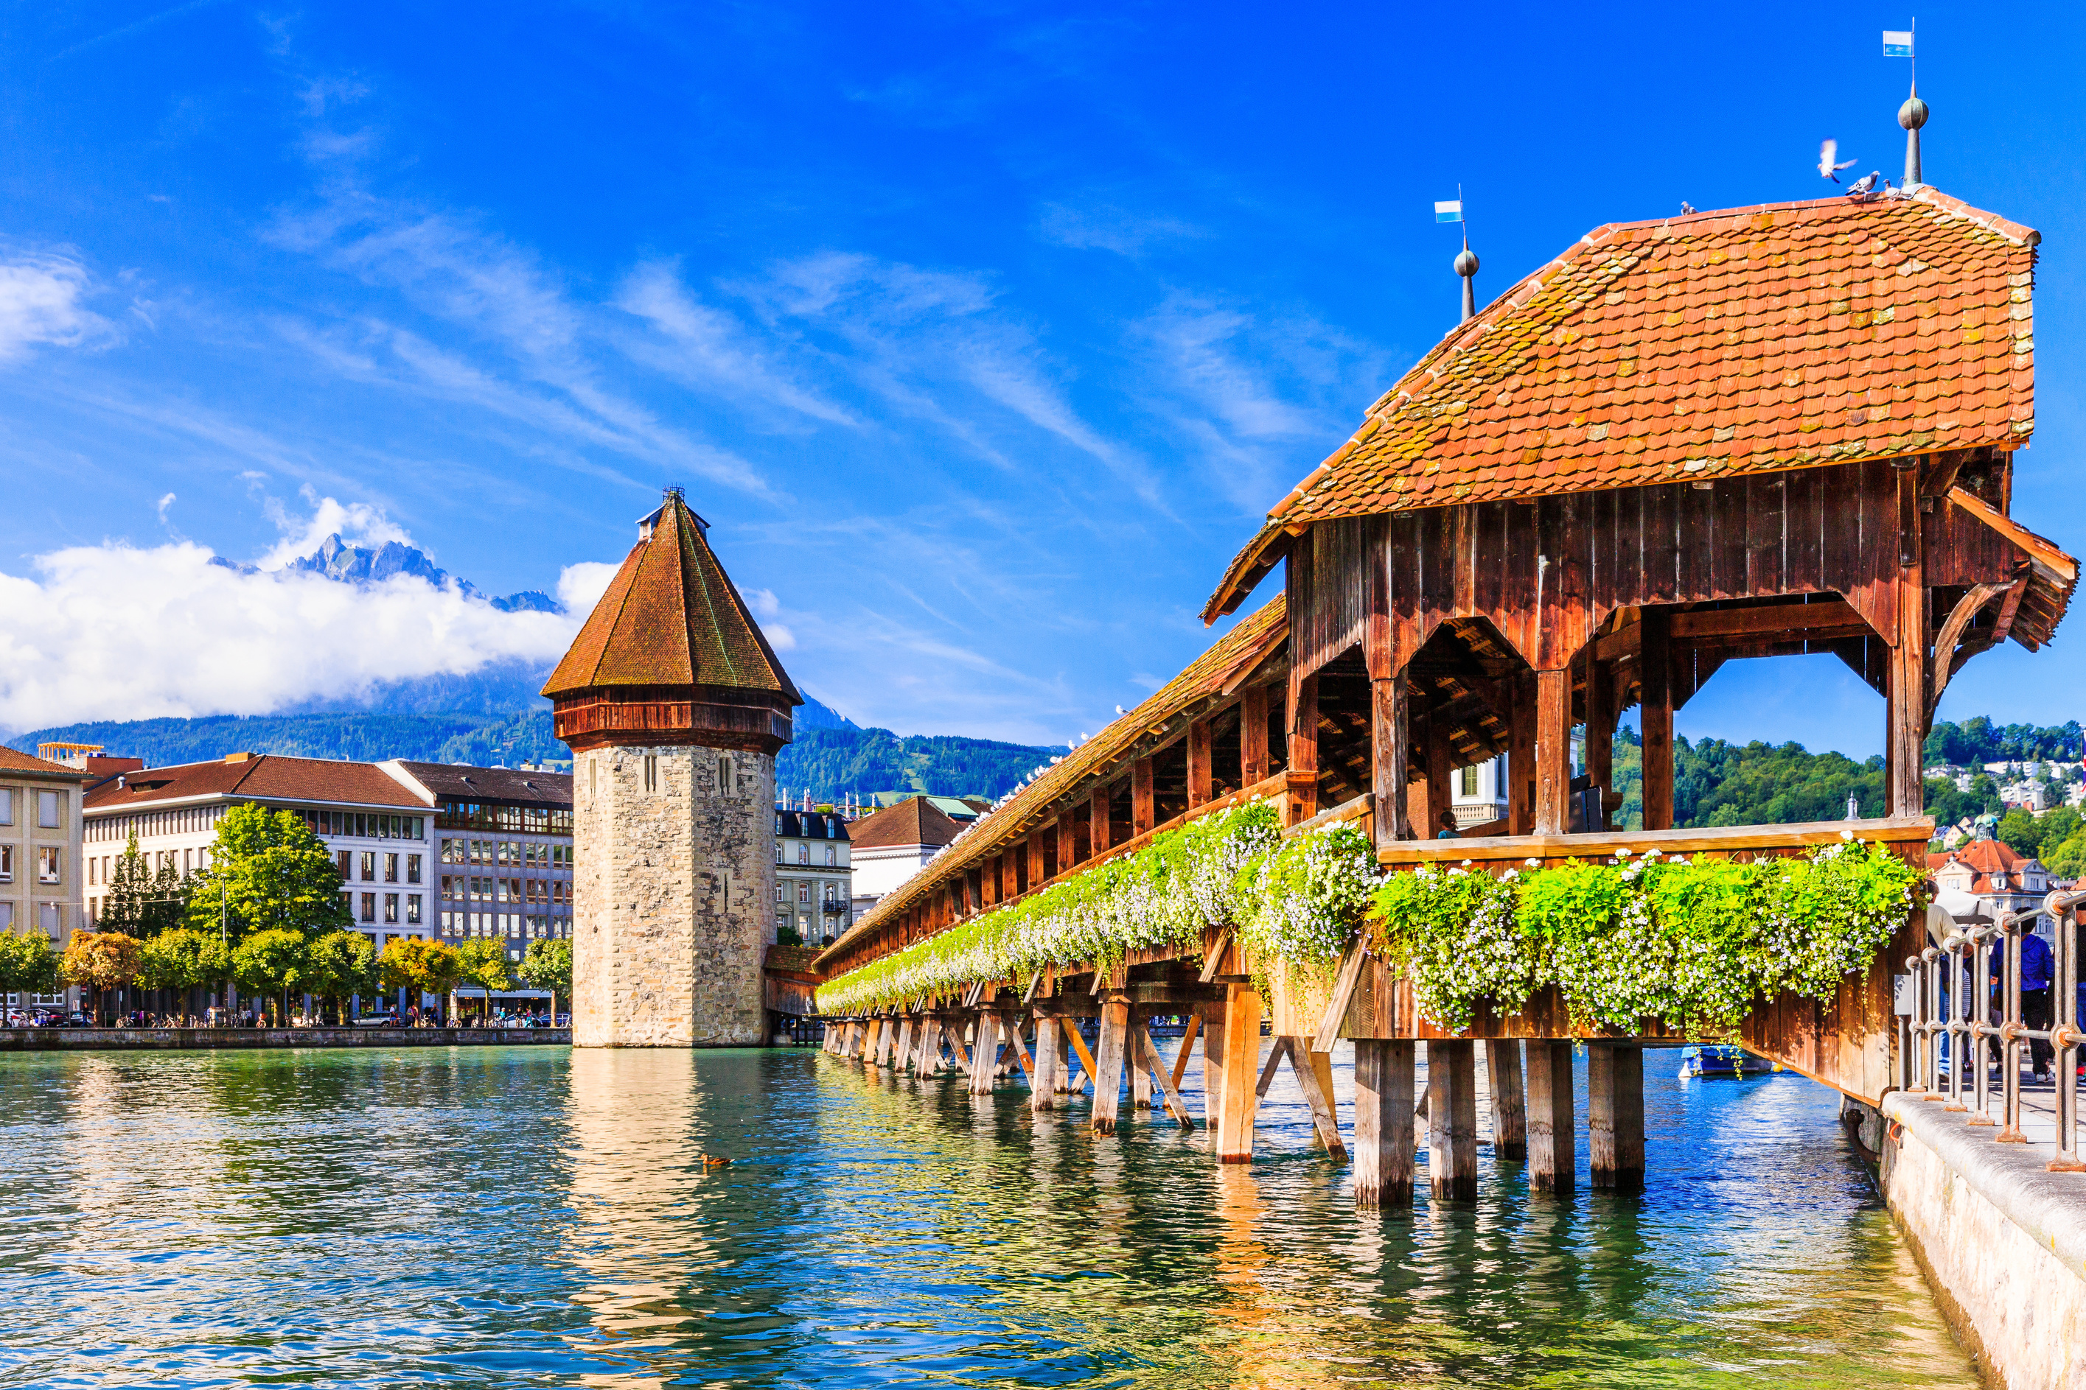

SECOND ACT
REFORMATION TOUR
May 31 - June 10, 2024

Slide 2
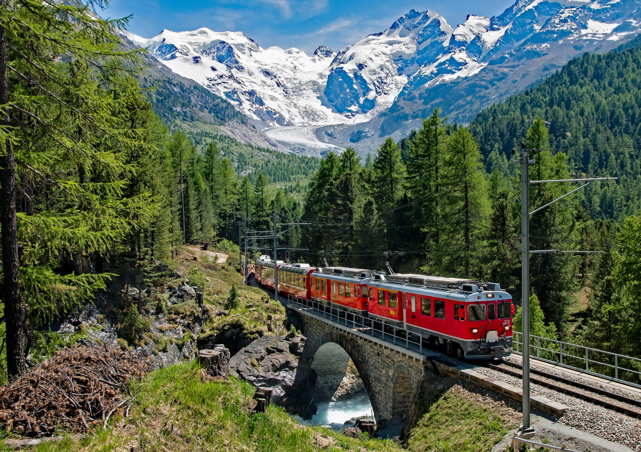
Members of Second Act are invited to spend 11 delightful days exploring Europe in style. After exploring Strasbourg in France, we’ll board the MS Symphonie for a 5-day cruise on the Rhine, past castles, vineyards, and the famous Lorelei Rock. Excursions are included, as well as fabulous French cuisine.
After our cruise, we will visit Lucerne by the French Alps, then we’ll take the historic Golden Pass route to Montreux. The final stage of our train ride is on the Orient Express in the famous Belle Epoque carriage. The tour will conclude with a Reformation Tour in Geneva.

Slide 3
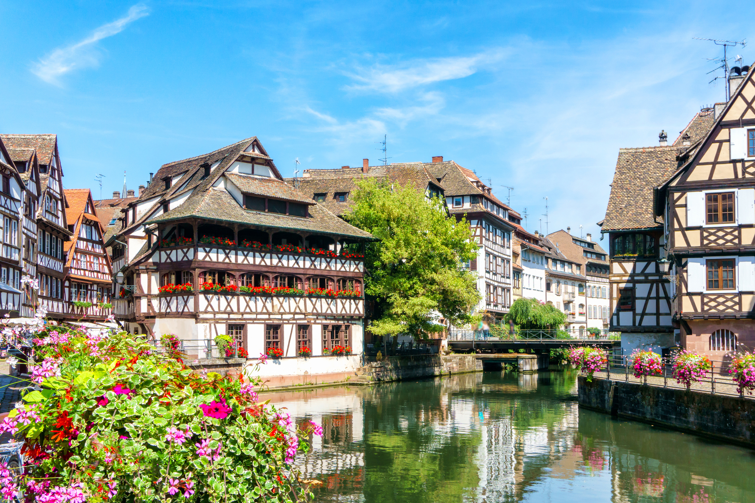
STRASBOURG, FRANCE
After landing in Frankfurt, Germany, our bus will take us to Strasbourg, France.

Slide 4
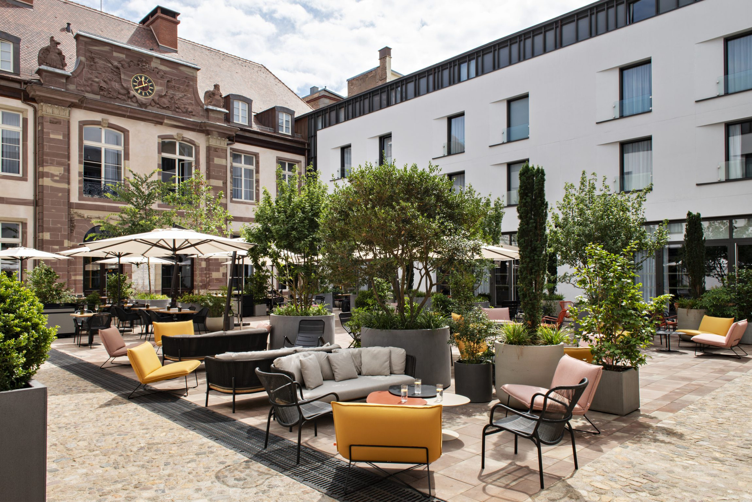
HOTEL LEONOR, STRASBOURG
The Leonor is a 4-star hotel in central Strasbourg. The historic building is now home to a luxury hotel, with a courtyard and restaurant that’s popular with local residents.
We will dine in the restaurant, where regional and seasonal products are prepared by expert chefs.

Slide 5
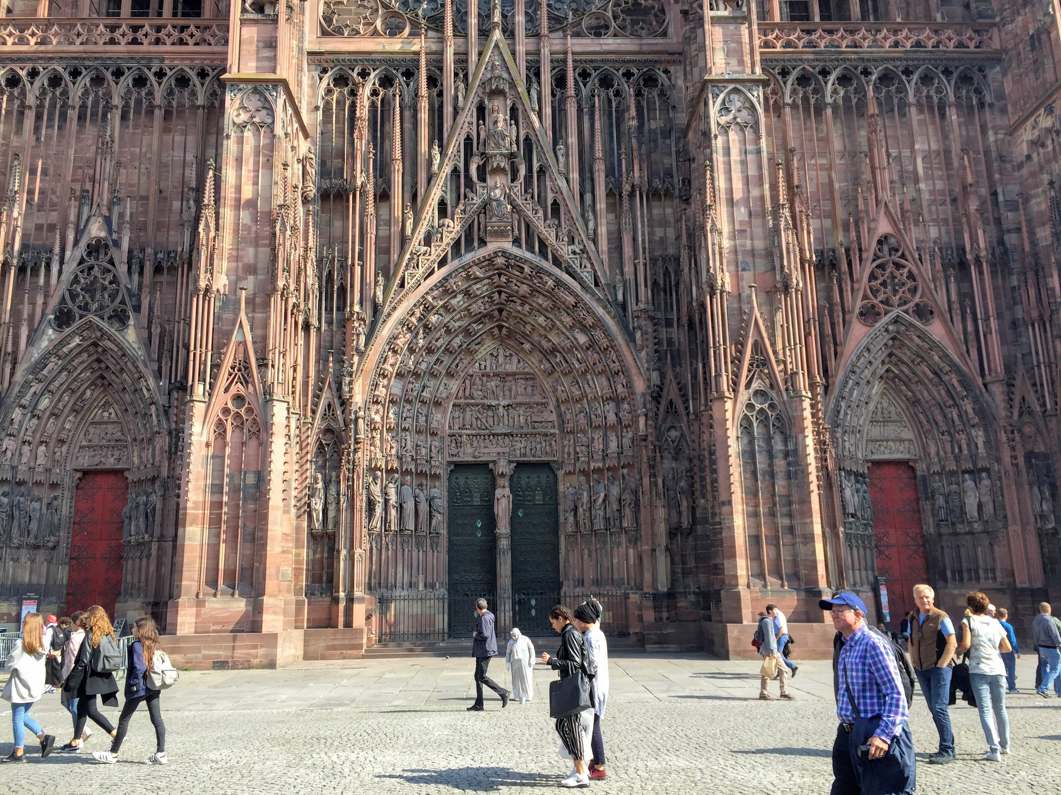
STRASBOURG TOUR
John Calvin spent many years in Strasbourg, during which he pastored French Huguenots, married, and write a second edition of his Institutes.
Our tour will include the stunning Cathedral, as well as the Petite France area, with half-timbered buildings.
We will also have an evening tour of Strasbourg after dinner.

Slide 6
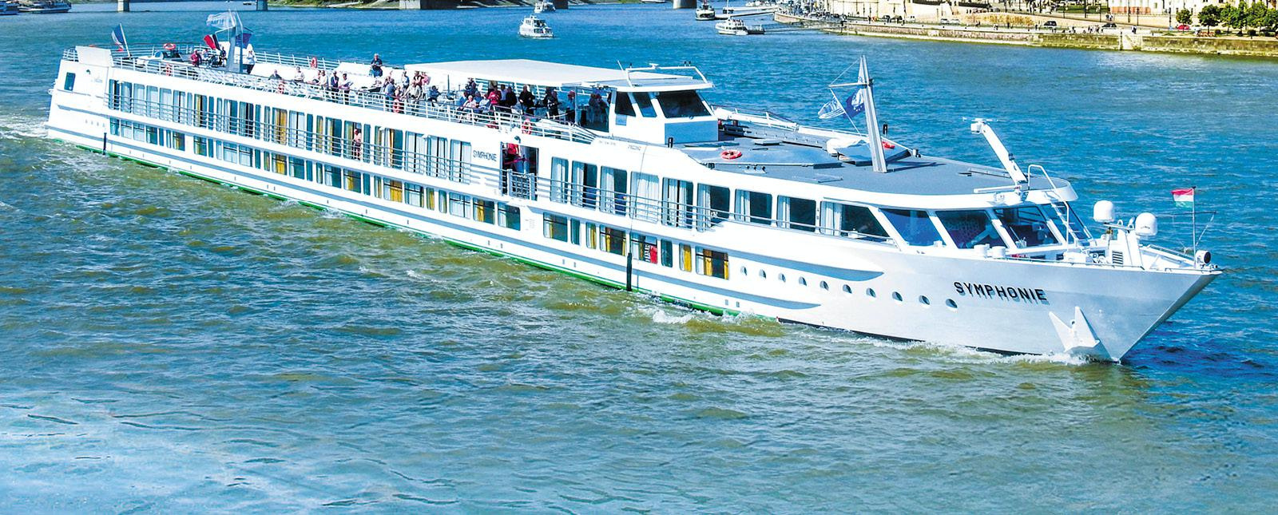
MS SYMPHONIE
Our next few days will be spent on our ship, the MS Symphonie, owned by Europe’s largest river cruise company, CroisiEurope. It was founded in Strasbourg in 1976 by Gerard Schmitter and it’s now run by his four children, who oversea over 50 ships all over the world. The ships are specifically designed to handle low water.

Slide 7
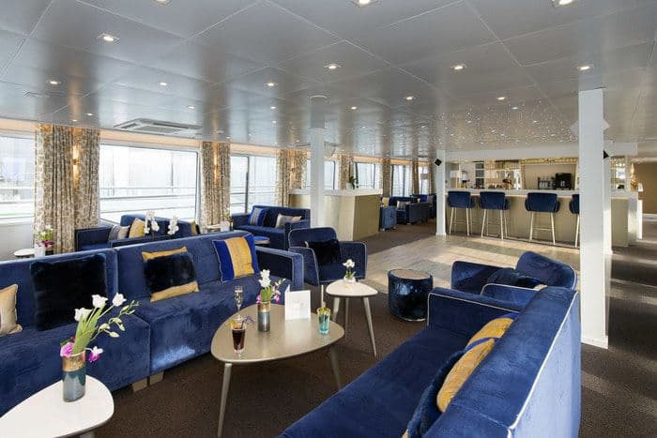
RELAXING ON BOARD
The sun deck has chairs to enjoy the scenery, as well as a covered area with tables and chairs.
The lounge area is on the upper deck with floor to ceiling windows and panoramic views.
There are many seating areas, as well as a dance floor and a well-stocked bar.
There are unlimited drinks throughout the day, including coffee, wine, and beer. There’s also a nightly cocktail.

Slide 8
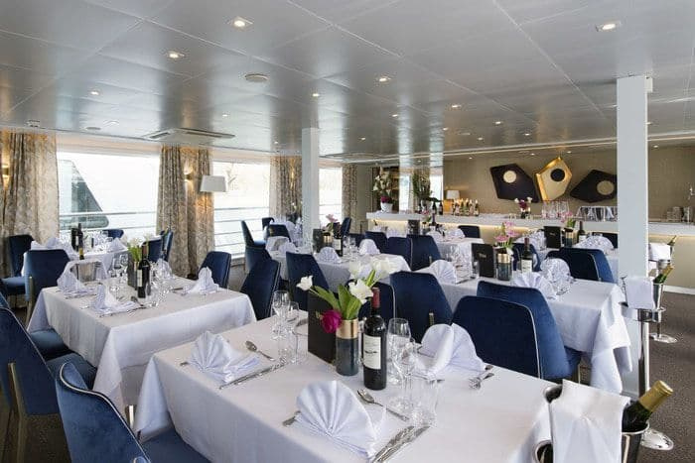
DINING ON BOARD
The restaurant is on the upper deck with floor to ceiling windows.
Breakfast and most lunches are buffet-style. The evening meal is table service.
The chefs are highly trained by renowned French chefs and the meals are superb. There is unlimited red and white wine, as well as soft drinks. Dietary restrictions are no problem.

Slide 9
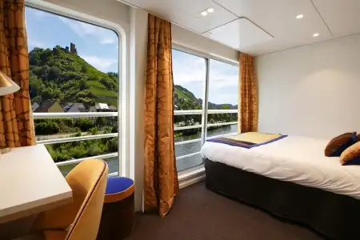
UPPER DECK CABINS
The upper deck cabins have French balconies, so the door slides open.
We have 8 double cabins (can be 1 or 2 beds) and 2 single cabins reserved.
The cabins have bathrooms, a television, and plenty of storage.

Slide 10
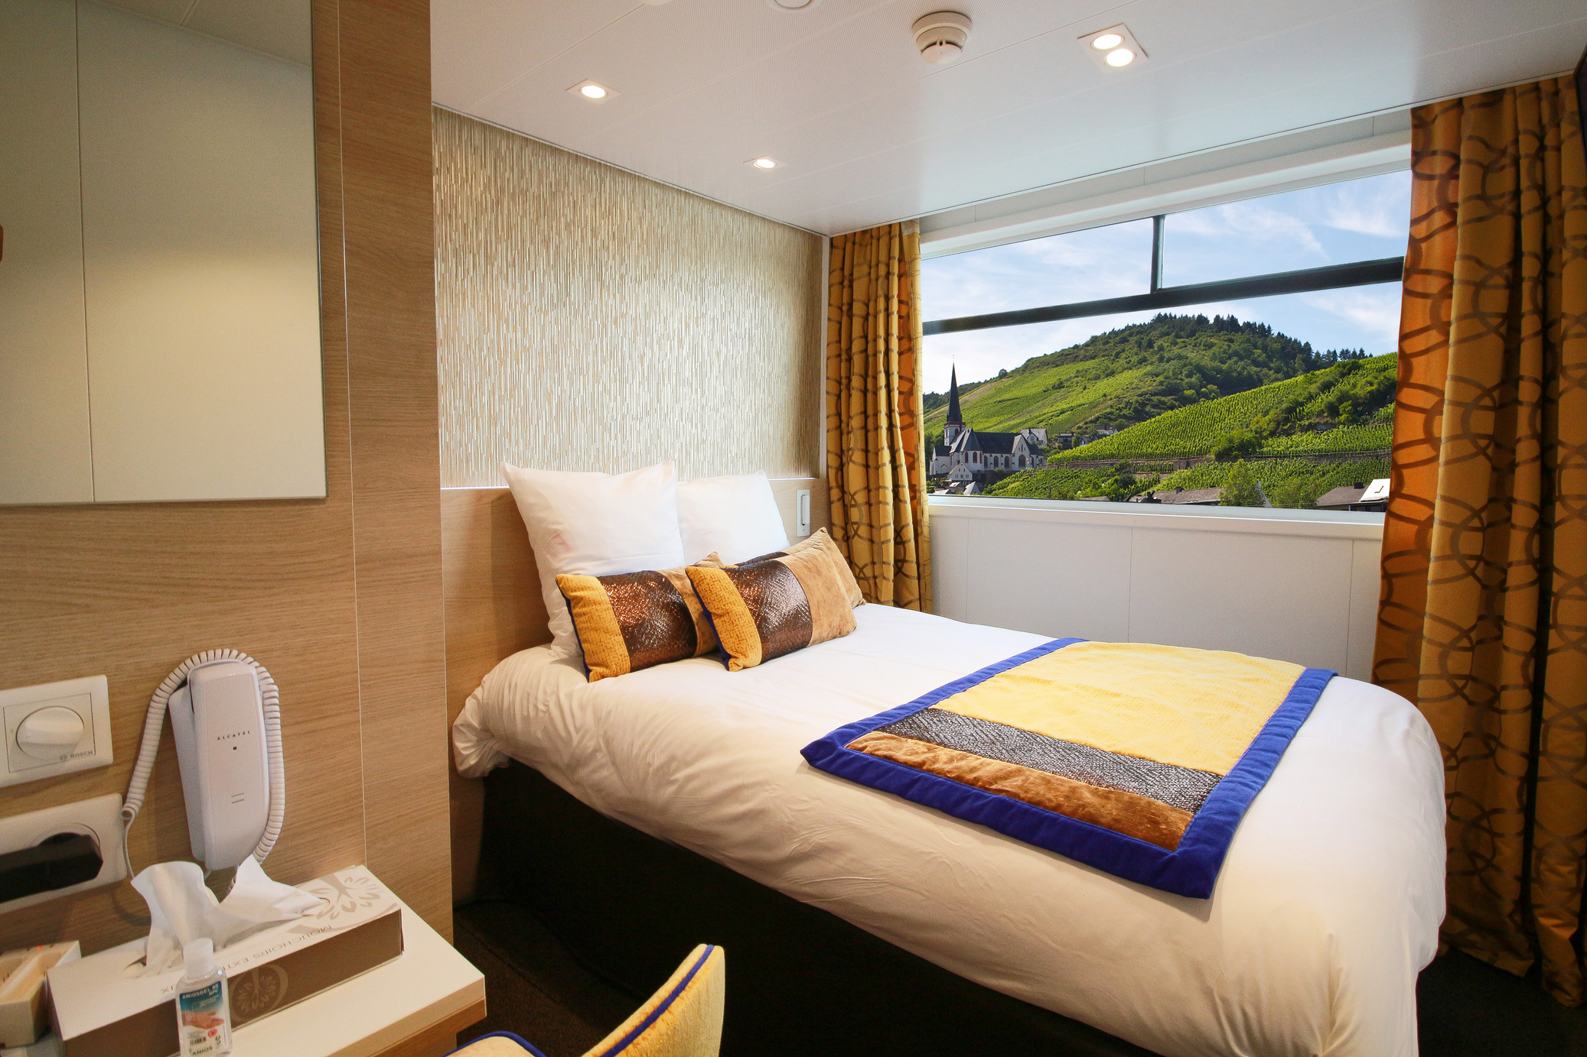
LOWER DECK CABINS
The lower deck cabins have windows that extend from wall-to-wall, from waist height up. Part of the window opens.
We have 7 double cabins (can be 1 or 2 beds) reserved.
The cabins have bathrooms, a television, and plenty of storage.

Slide 11
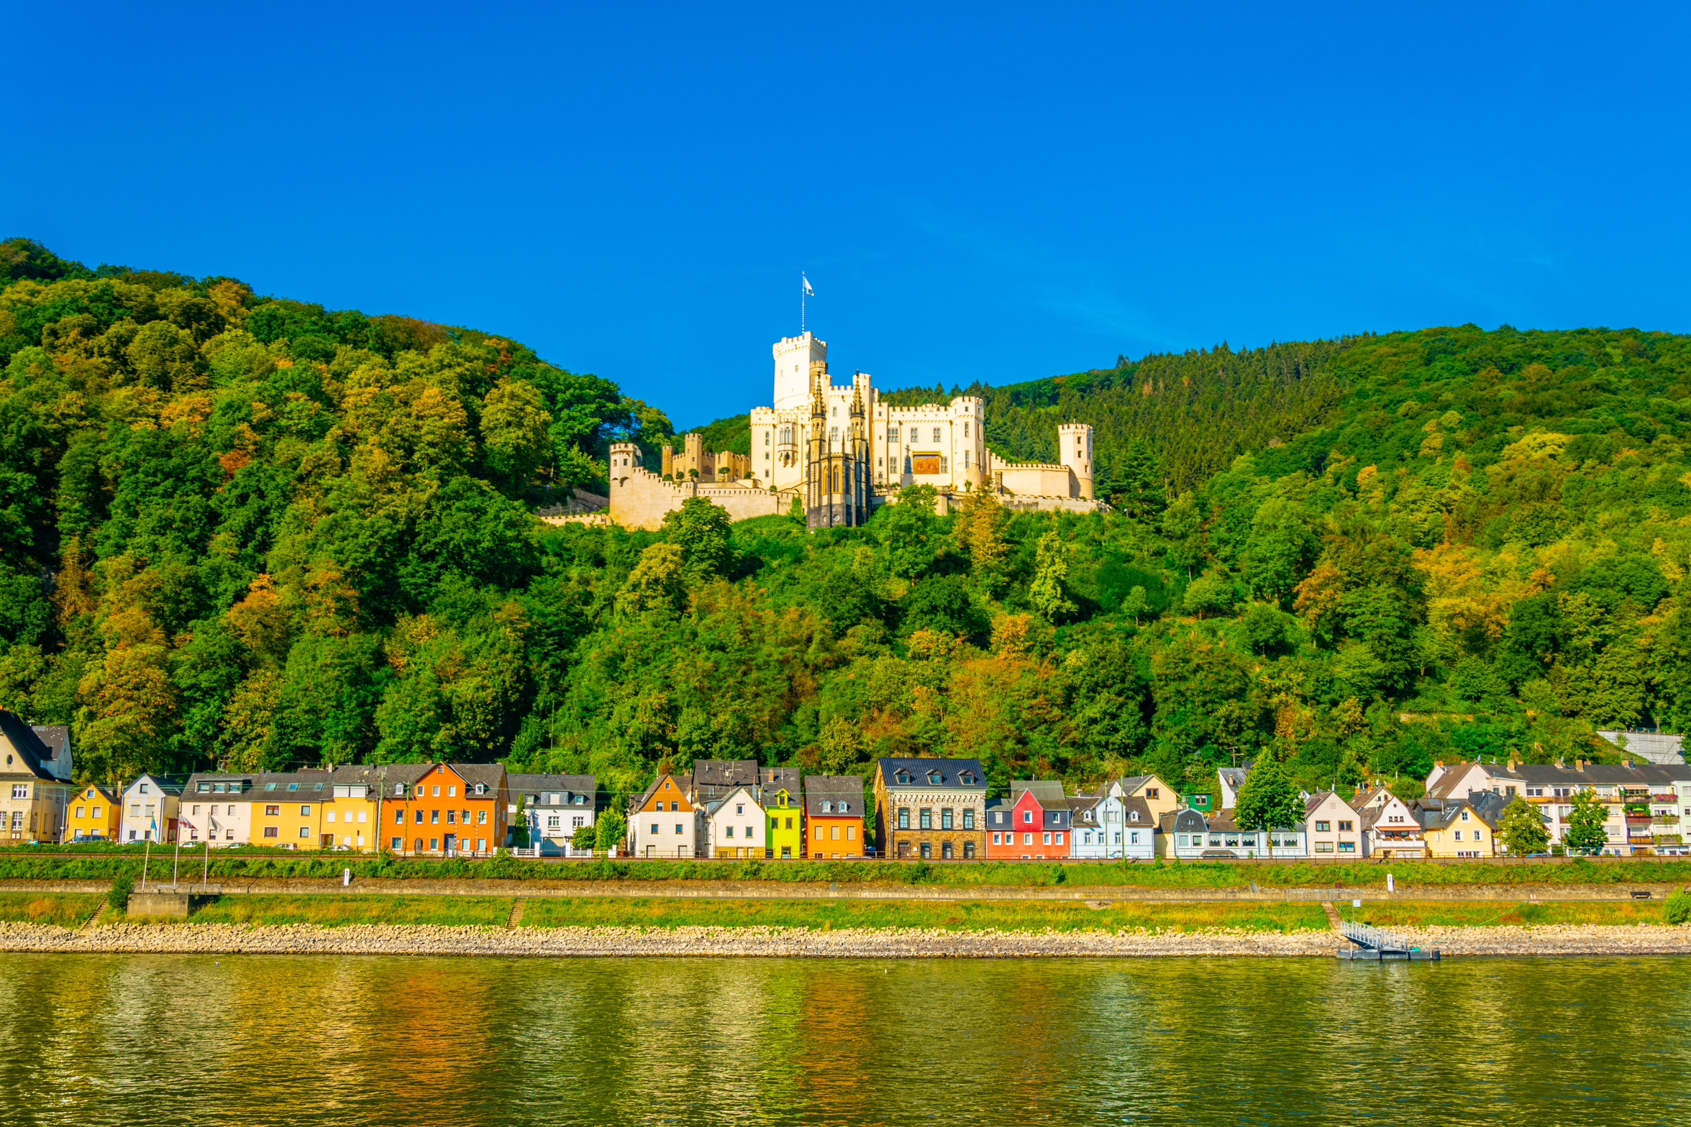
SAILING ON THE RHINE
As the ship sails towards Koblenz, we will view towns like Lauterbourg, Spire and Mainz and some of the most beautiful sections of the Rhine.
We will view Stolzenfels Castle before we arrive in Koblenz.

Slide 12
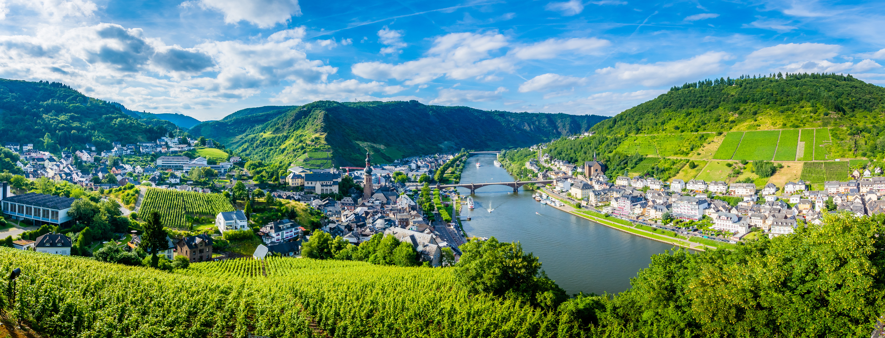
KOBLENZ
We will arrive in Koblenz late afternoon and we will explore the city with our ship guides.
Koblenz, one of Germany’s most beautiful cities, is at the confluence of the Rhine and Moselle. It’s known as Deutsches Eck or German Corner. This 2,000 year old city is surrounded with vineyards.

Slide 13
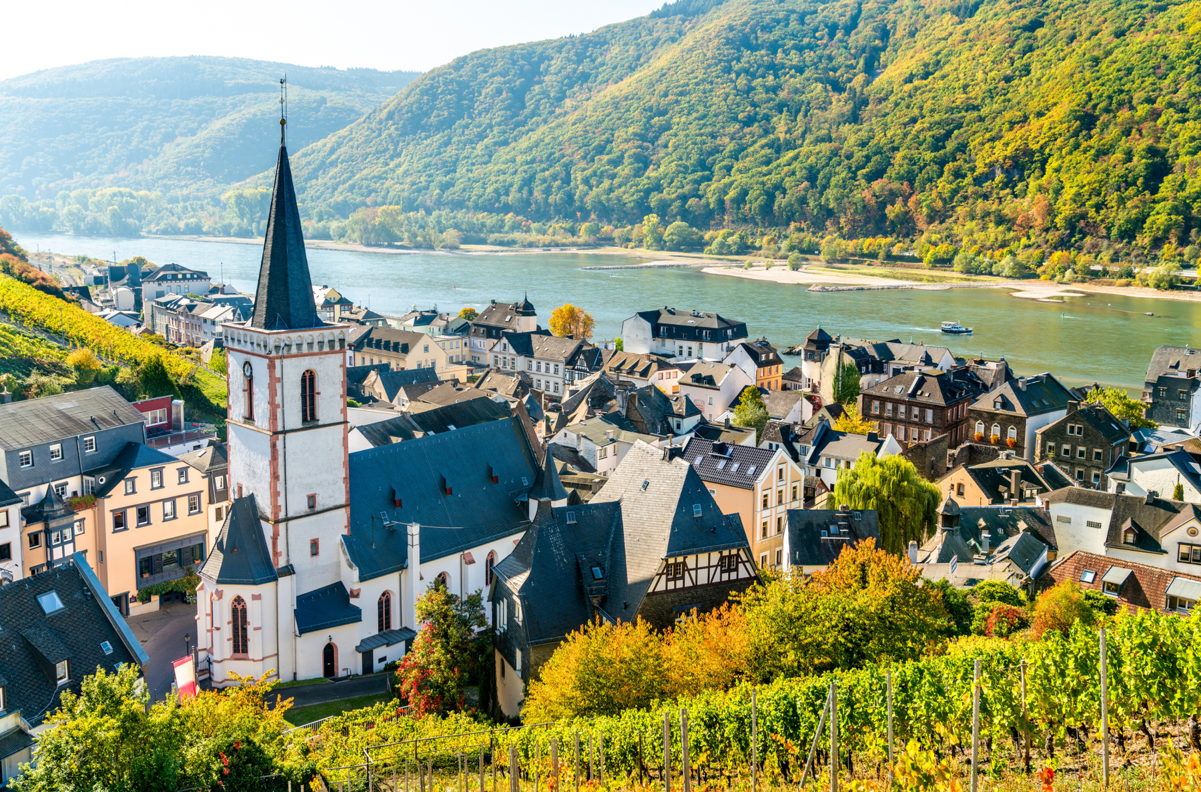
RUDESHEIM
On the scenic part of the Rhine between Koblenz and Rüdesheim we will pass by numerous castles, vineyards, and the famed Lorelei Rock.
In the afternoon, our include excursion is on a touristic train stopping at a 16th century wine-tasting cellar, followed by a visit to a museum of mechanical musical instruments.

Slide 14
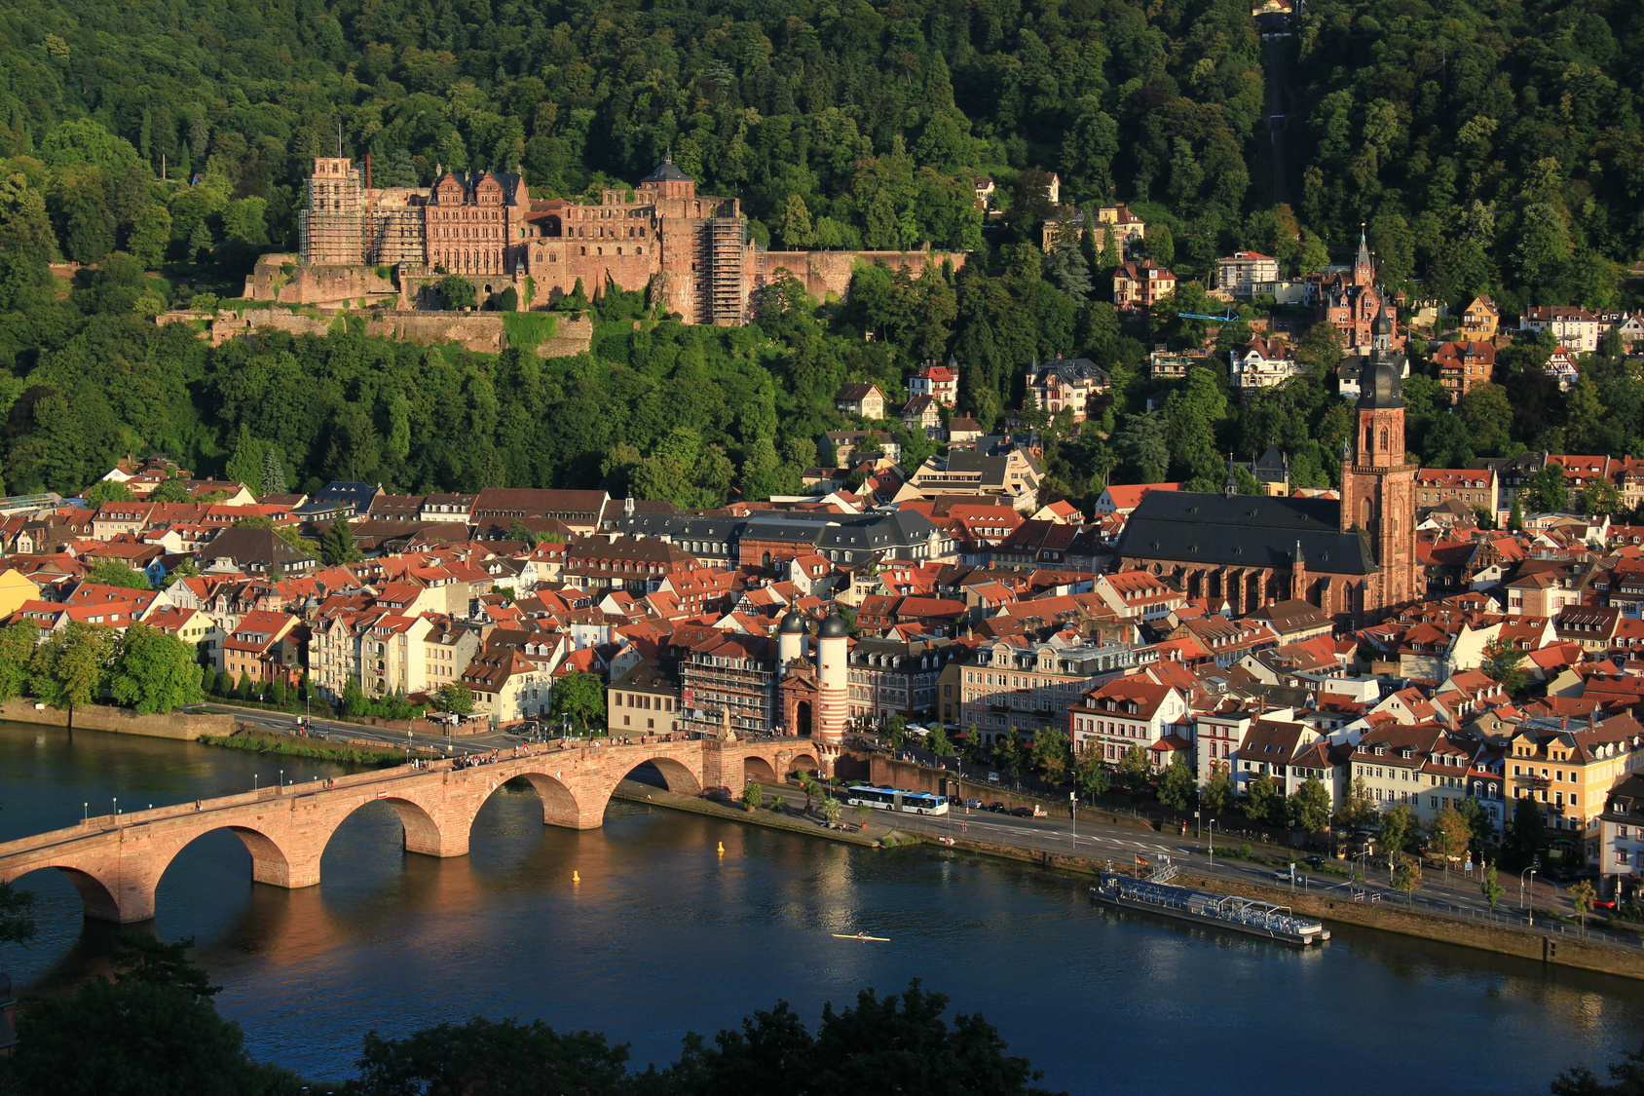
HEIDELBERG
After sailing by Wiesbaden, Nierstein and Worms, we will enjoy the included excursion to Heidelberg.
We’ll see the outside of Heidelberg Castle, stroll in the gardens, explore the old city, then enjoy some free time
This evening is the special gala evening (smart casual) on board.

Slide 15
LUCERNE
After a final breakfast on board, we will board our bus and drive through the Black Forest region to Lucerne.
We will explore the medieval streets of Lucerne, including the Old Town, the Kornmarkt (grain market), the Old Town Hall, the restored houses at the Hirschenplatz, the famous Chapel Bridge and the Jesuits’ Church, which dates back to 1667

Slide 16
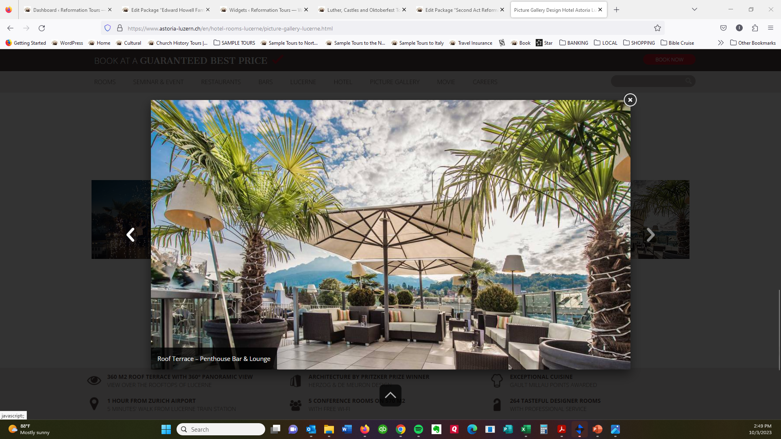
HOTEL ASTORIA, LUCERNE
The Astoria is a 4-star hotel in central Lucerne, designed by renowned architects.
The hotel has three award-winning restaurants, a rooftop garden lounge, and a bar with panoramic views.

Slide 17
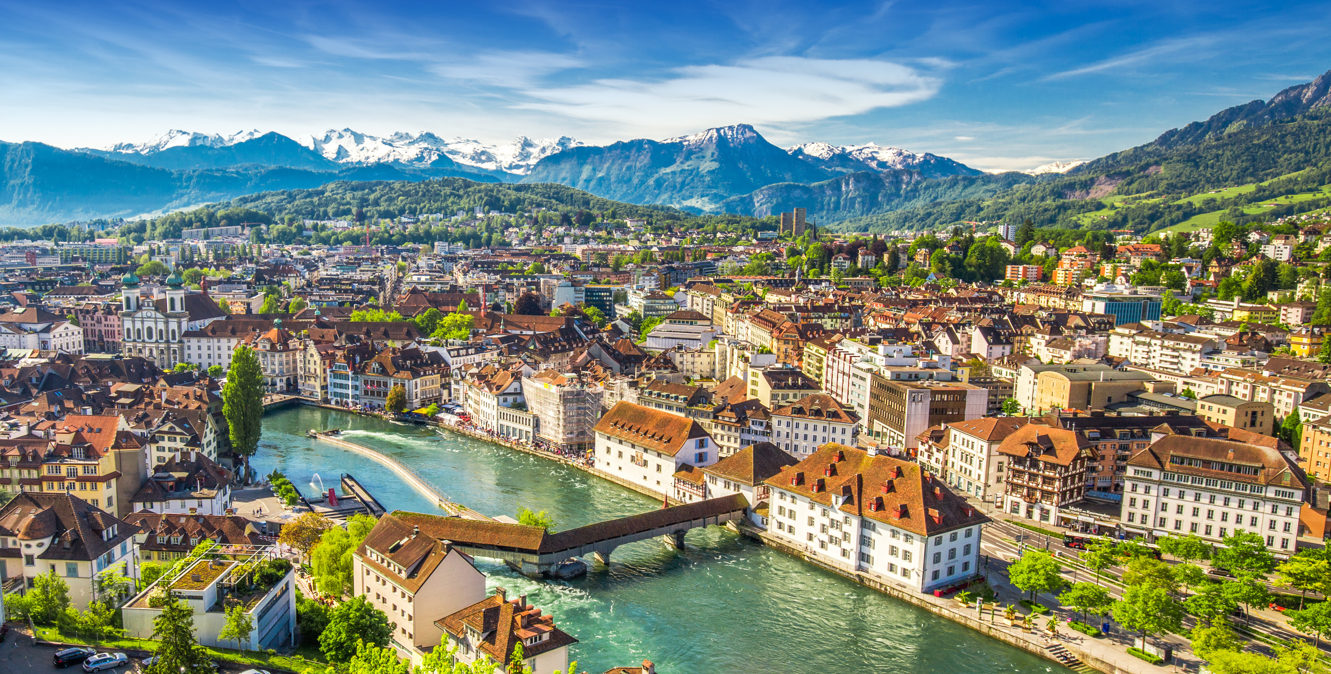
LUCERNE
Today we have a free day to explore Lucerne at leisure, visit Mount Pilatus, or Zurich.

Slide 18
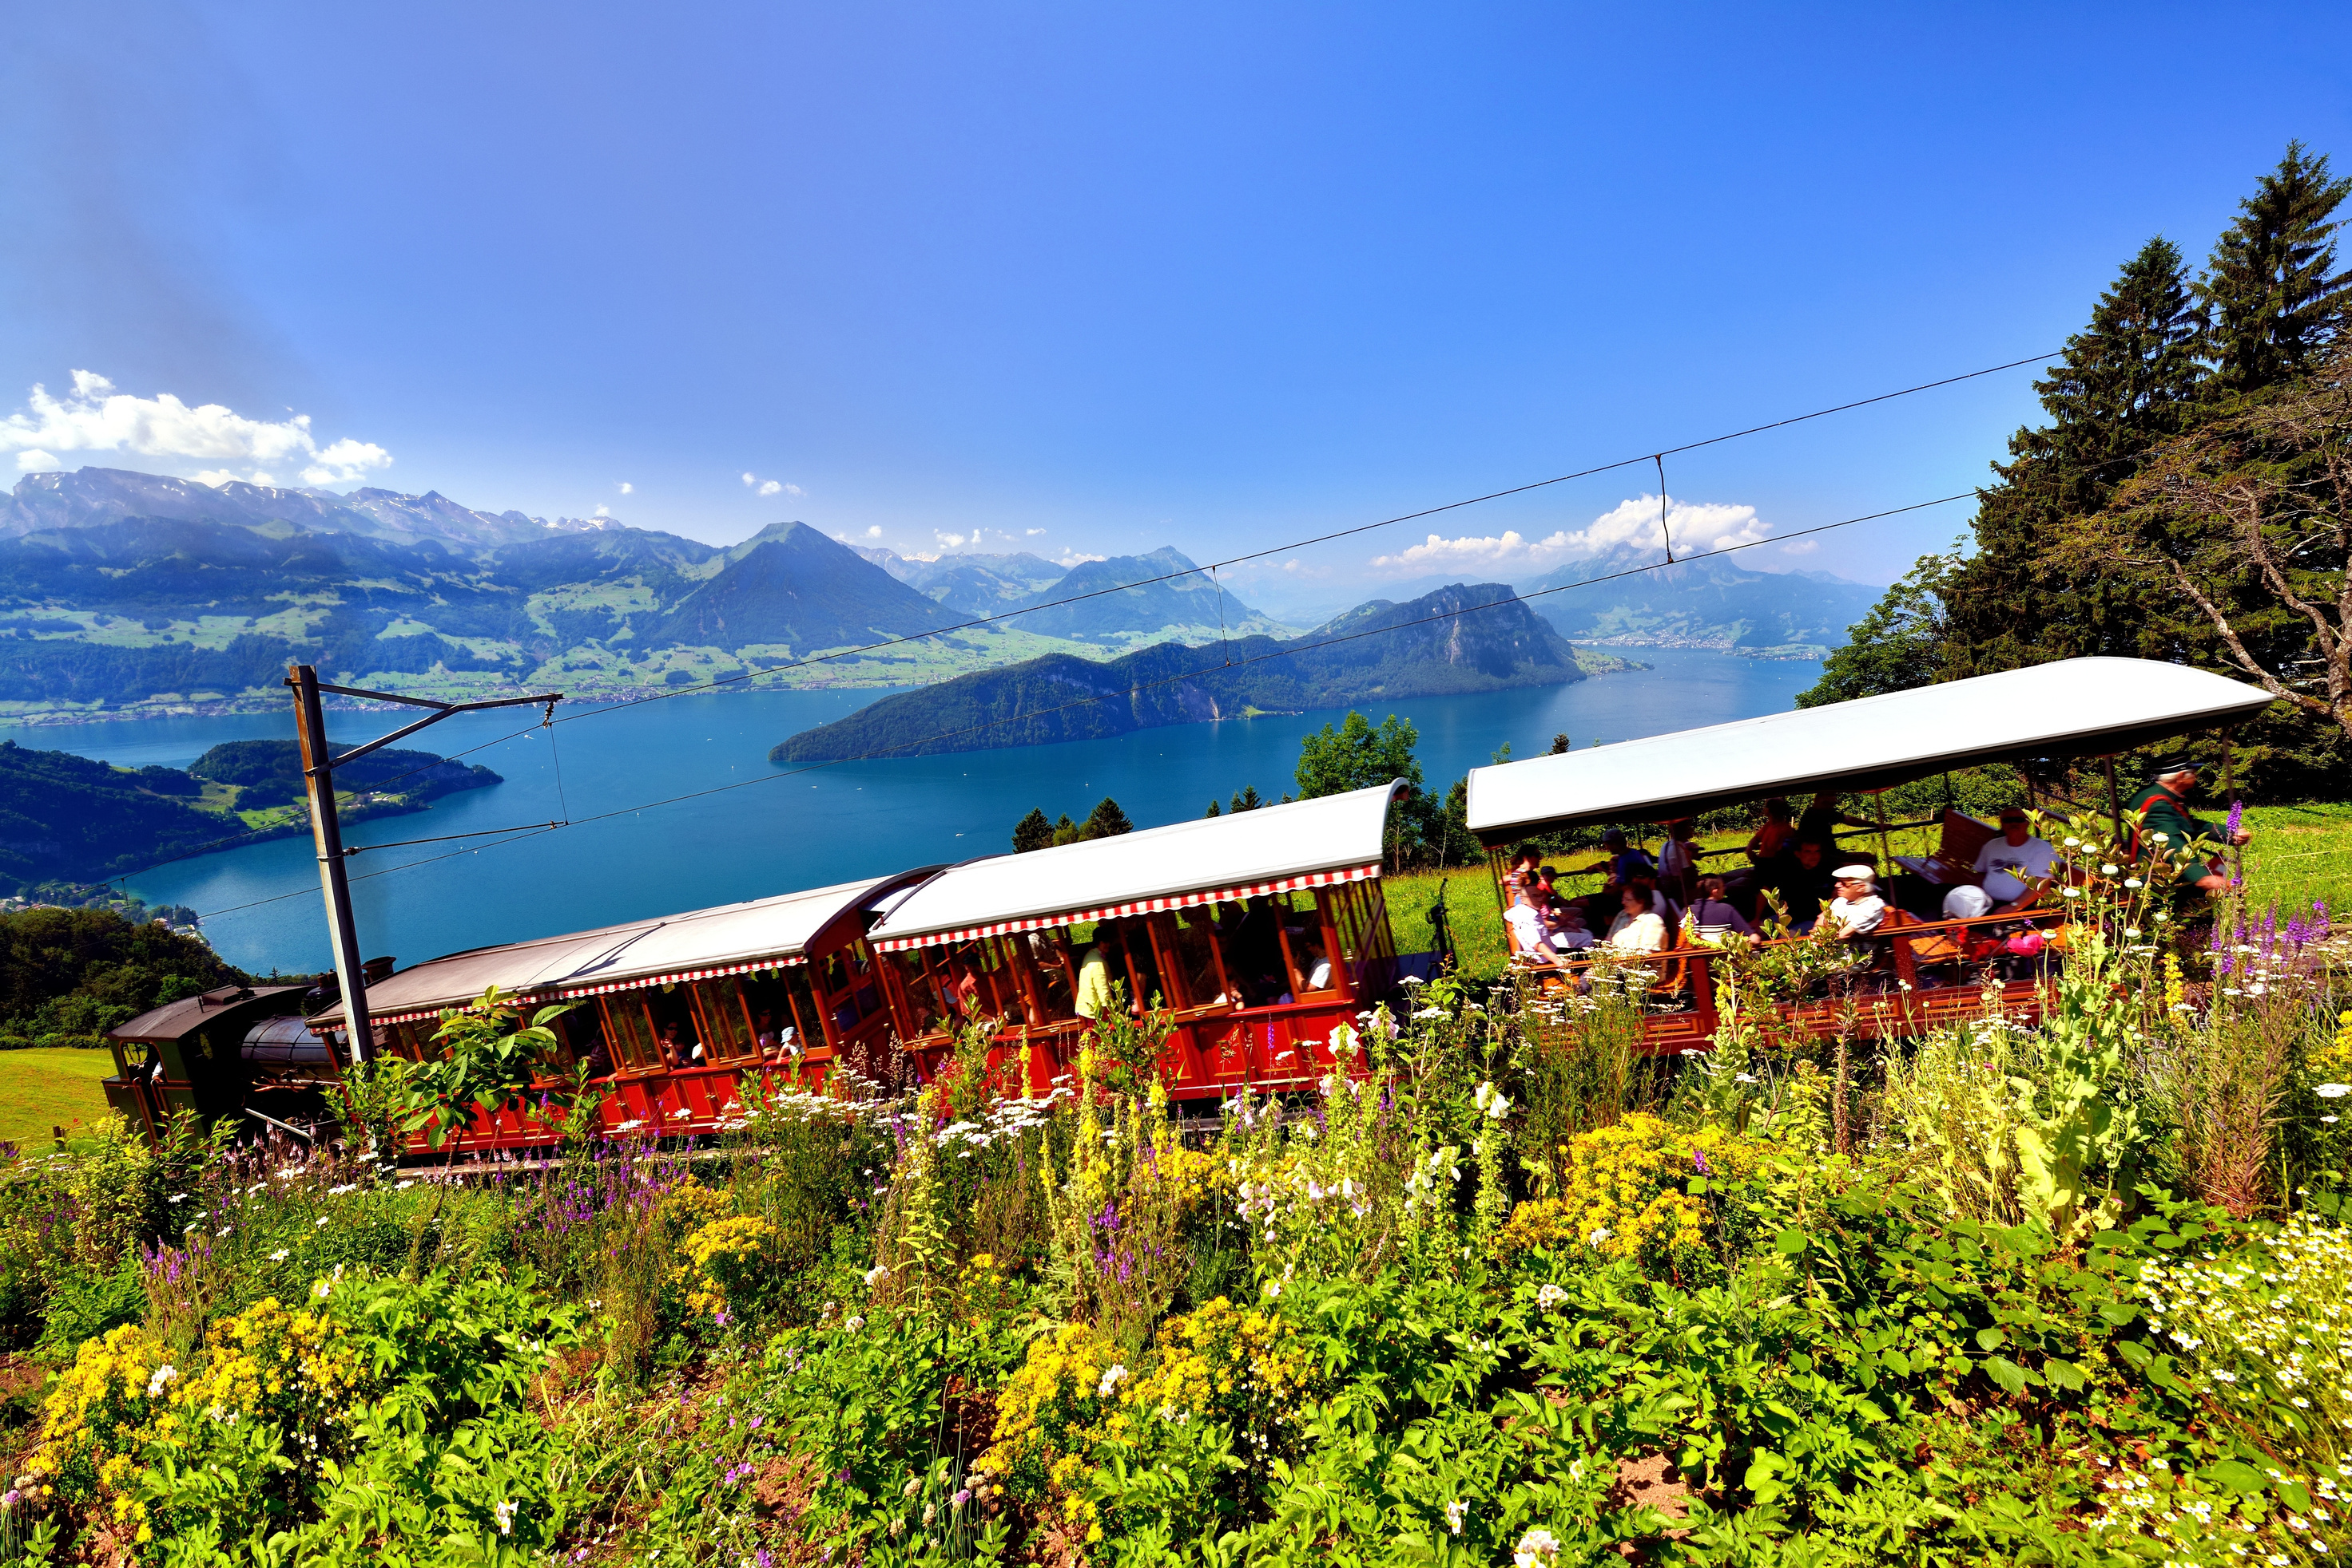
MOUNT PILATUS
The Mount Pilatus option includes a boat trip, a ride on the world’s steepest cogwheel railway, lunch on Mt. Pilatus, then reutrn on the Panorama Gondola and Aerial cable car. .

Slide 19
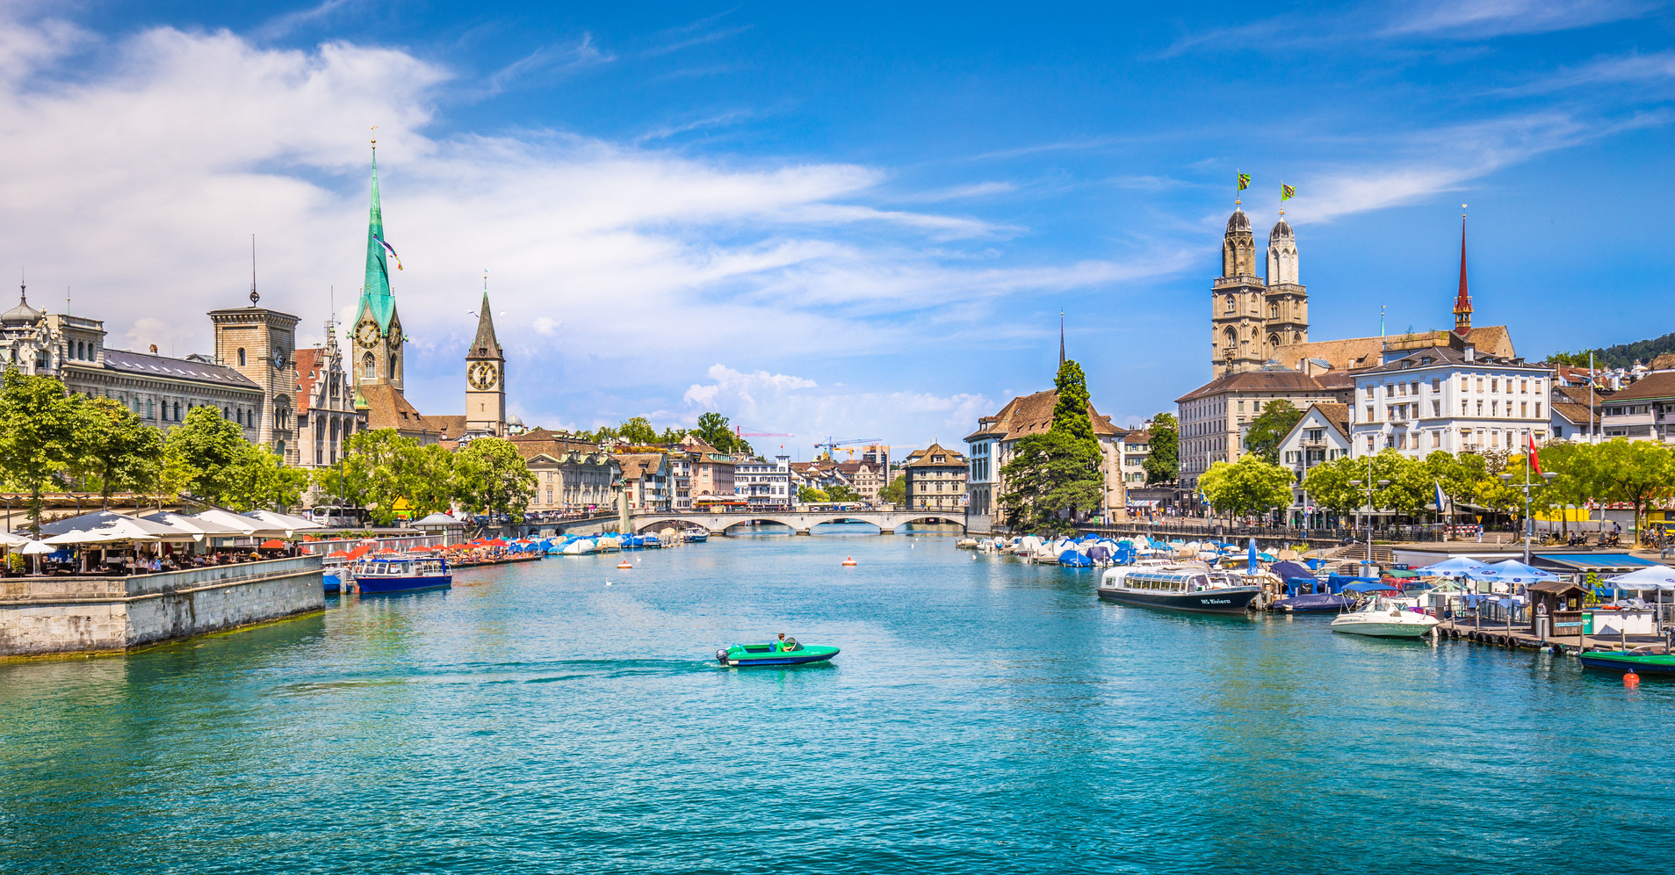
ZURICH
Zurich is an easy day trip on the train from Lucerne. This stunning Swiss city was home to Zwingli and the Anabaptists.

Slide 20
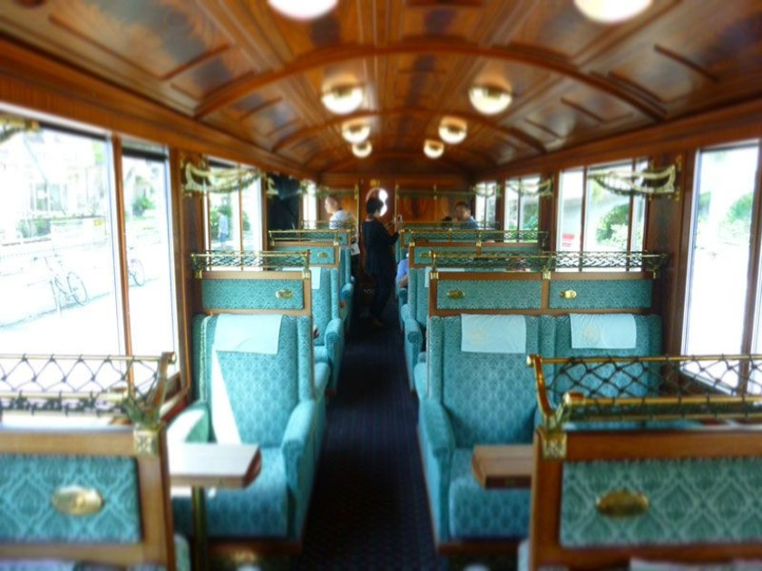
GOLDEN PASS
There’s no better way to explore Switzerland than by train. Our bags will be taken to our hotel, so we are free to enjoy the trip.
We will drive to Interlaken, then board to train to Spiez, change for the train to Zweisimmen. The final part of our journey is the luxurious Belle Epoque carriage. The views coming to Montreux are stunning.

Slide 21
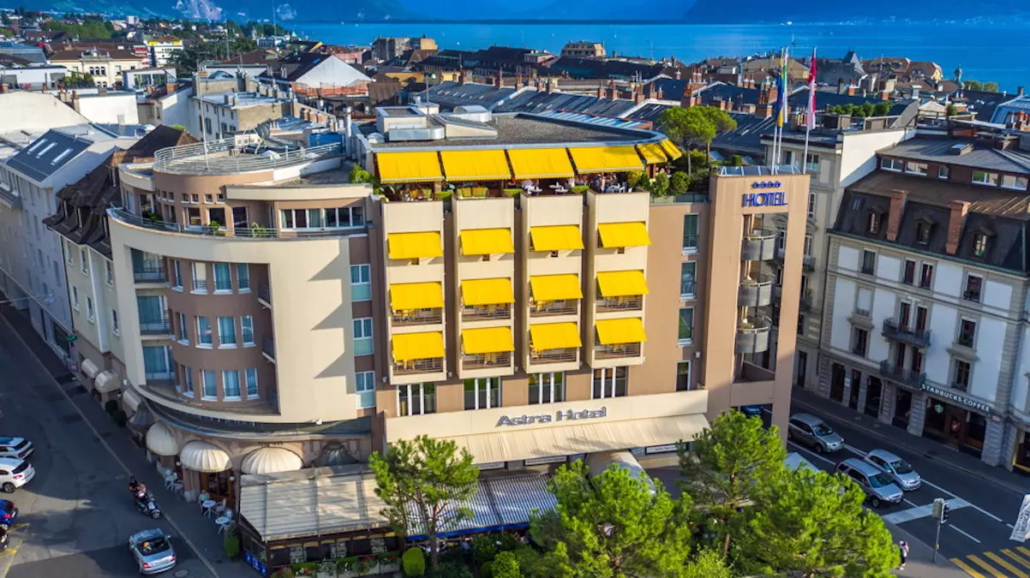
HOTEL ASTRA, VEVEY
The Astra is a 4-star hotel with distinctive yellow blinds, in central Vevey, close to Lake Lucerne.
The hotel has a historic brasserie, a lobby bar, and a rooftop panoramic bar and lounge. There’s also a spa and jacuzzi on the rooftop.

Slide 22
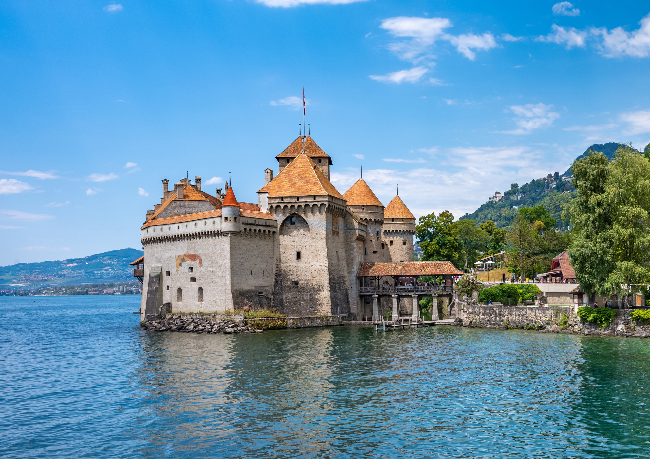
CHILLON CASTLE
Chillon Castle has a fabulous setting on Lake Lucerne.
We will explore the castle and enjoy the views. The famous poem Prisoner of Chillon was written about 16th century Bishop Bonivard, who was imprisoned here. He devoted his life to the cause of liberty and rights of the Swiss people.

Slide 23
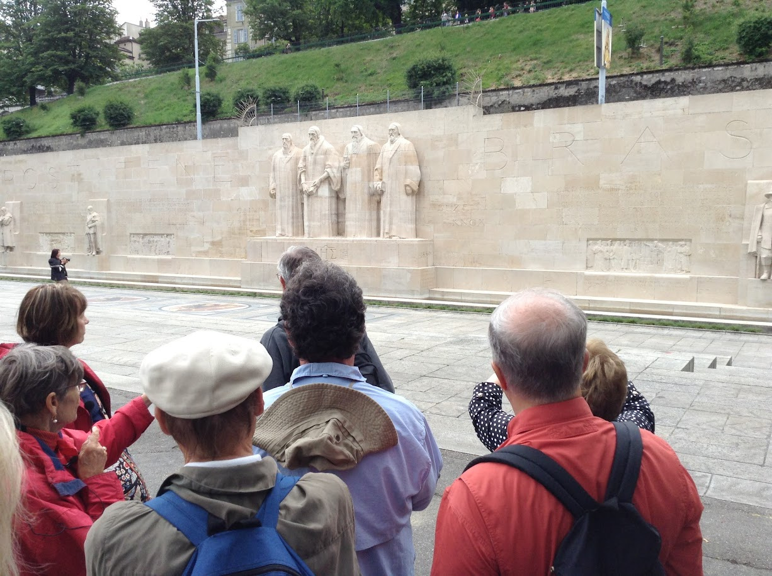
GENEVA
We will take a scenic train ride today alongside the lake to Geneva. We will attend a church service in the Auditoire de Calvin, then have a Reformation-themed tour. We will see the Reformation Wall, the Reformation Museum, St. Peter’s and the archeological museum.

Slide 24
WHAT’S INCLUDED
  Transportation: via deluxe air-conditioned coaches
  Accommodations (double occupancy) in 4-star hotels
  Cruise, including shore excursions, tips, and drinks
  Meals and attractions as indicated in the itinerary
  Professional Tour Manager / Cruise Director
  Local step-on guides for city tours and major attractions
  Guides will use Whisper Headsets throughout the tour
  Admission to all activities indicated in the itinerary
  Group arrival and departure transfers
  All taxes and tips
  Personalized travel app
  Full color tour book

Slide 25
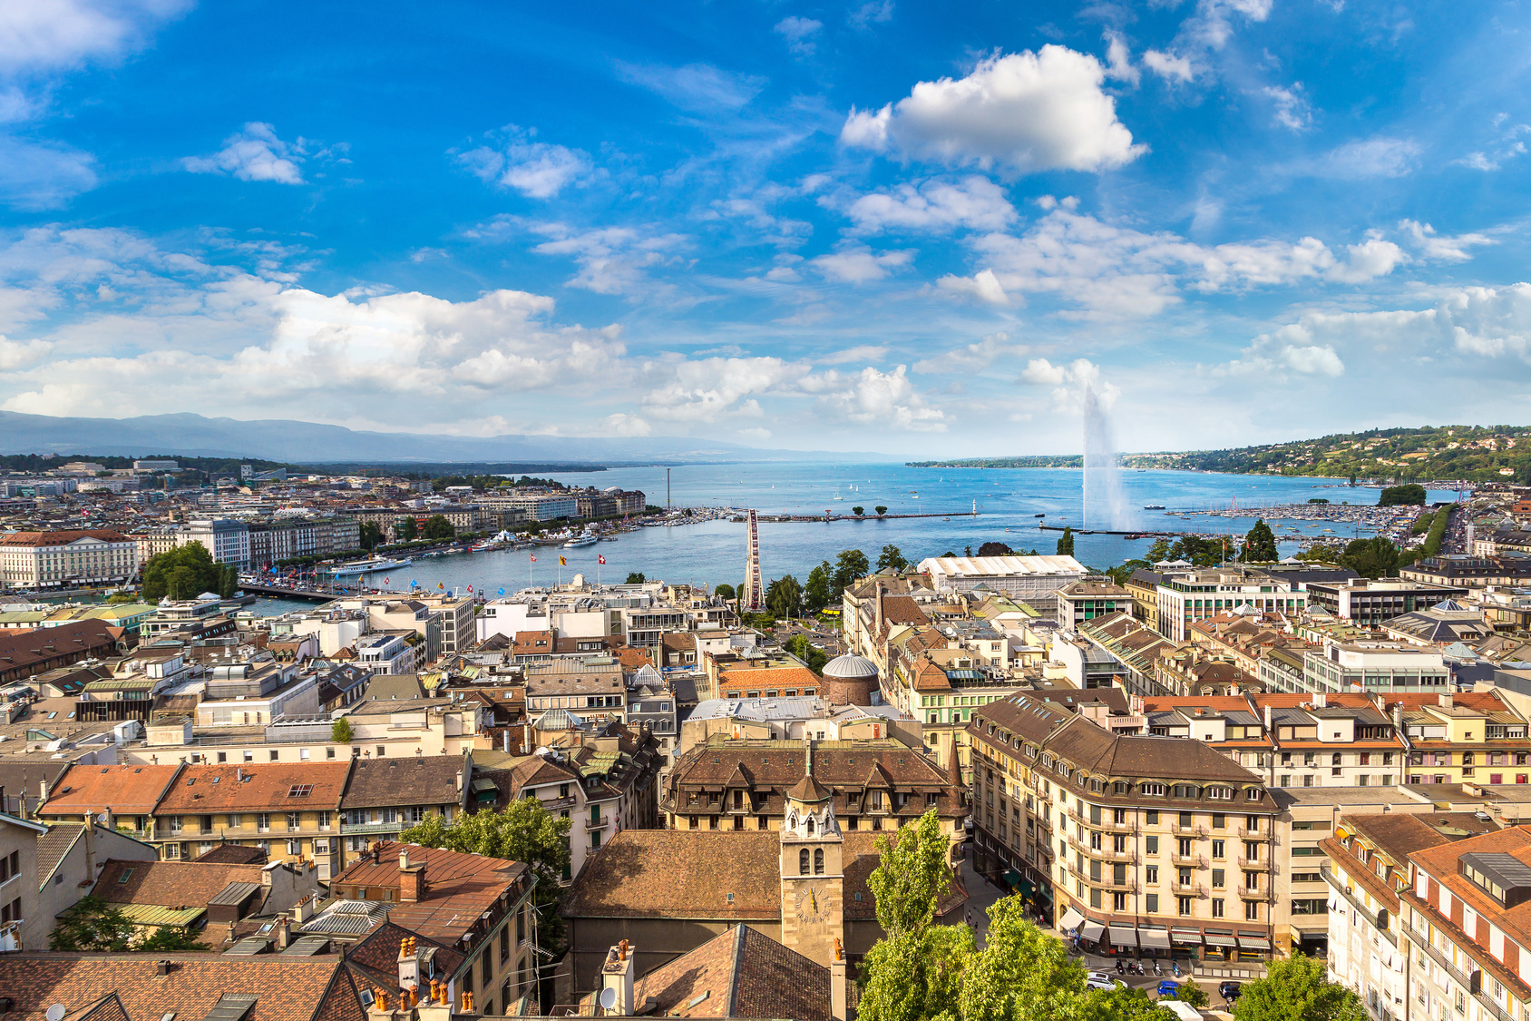
WHAT’S NOT INCLUDED
  Round-trip air transportation (quote pending)
  Individual arrival and departure transfers, if not with the group
  Supplement for single occupancy ($1,390)
  Meals and beverages not identified in itinerary
  Passenger trip cancellation insurance (options available)

Slide 26
HOW TO REGISTER
SIGN UP: Please click the registration link on the website: ReformationTours.com/package/RCD24.
PAYMENT METHOD: Payments can be made directly on the registration platform, using a credit card (3.5% fee), or a bank debit. You can also send checks made payable to “Reformation Tours” at 12316 244th St., Chisago City, MN 55013-9688.
FIRST DEPOSIT: A $350 per person
FINAL PAYMENT: Due by March 2, 2024.
TRAVEL INSURANCE: We highly recommended insuring your tour and there are two options (see below). Enhanced insurance needs to be paid within two weeks of paying the deposit.
I

