Slide 1
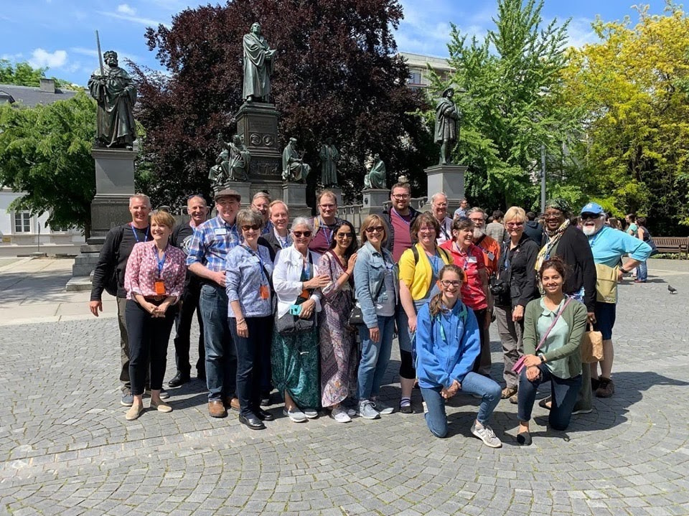
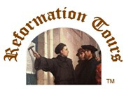
PRAGUE TO GENEVA REFORMATION STUDY TOUR
May 31 - June 10, 2024

Slide 2
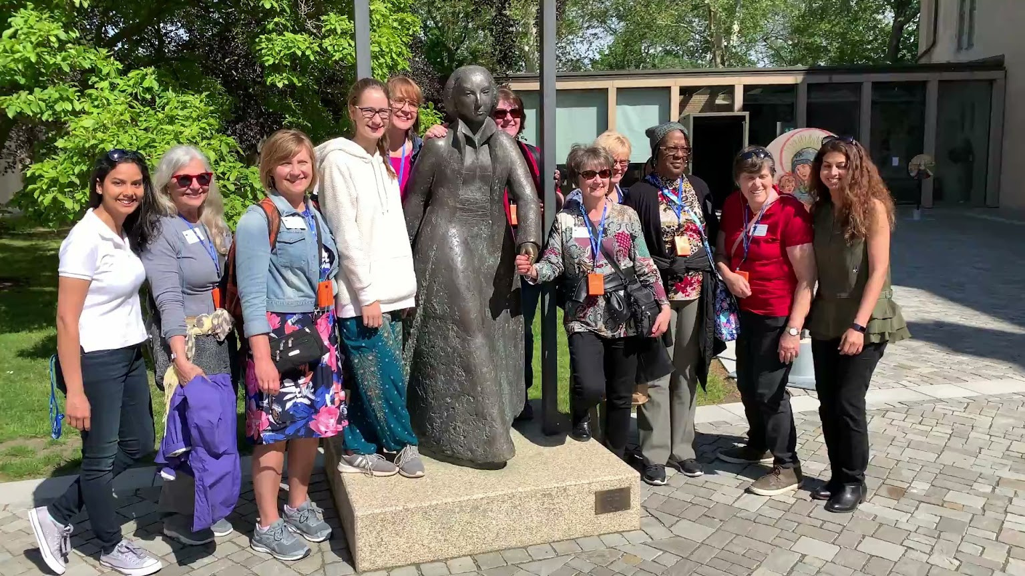
You are invited to join Dr. Joe Thomas, and Dr. Mark Draper as they trace our rich Protestant heritage through four countries: Czech Republic, France, Germany, and Switzerland. Joe and Mark co-teach a doctoral level course on the Reformation and this is their second time leading a Reformation Tour.
On this 11-day journey, Joe and Mark will be sharing insights about the spiritual life of the Reformers, with a focus on the context and application of their teachings. There will also be time for spiritual reflection and group discussions. Suggestions for pre-tour study materials will be available.

Slide 3
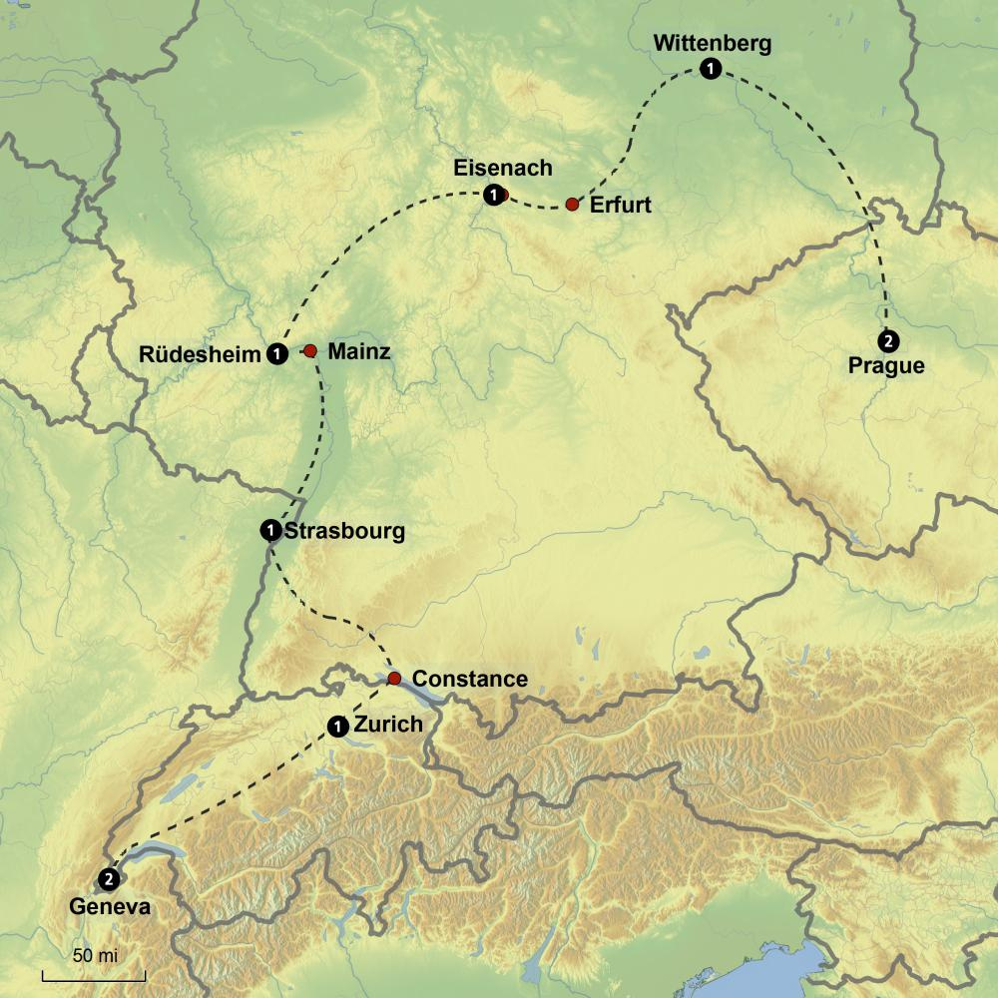
MAP OF THE TOUR

Slide 4
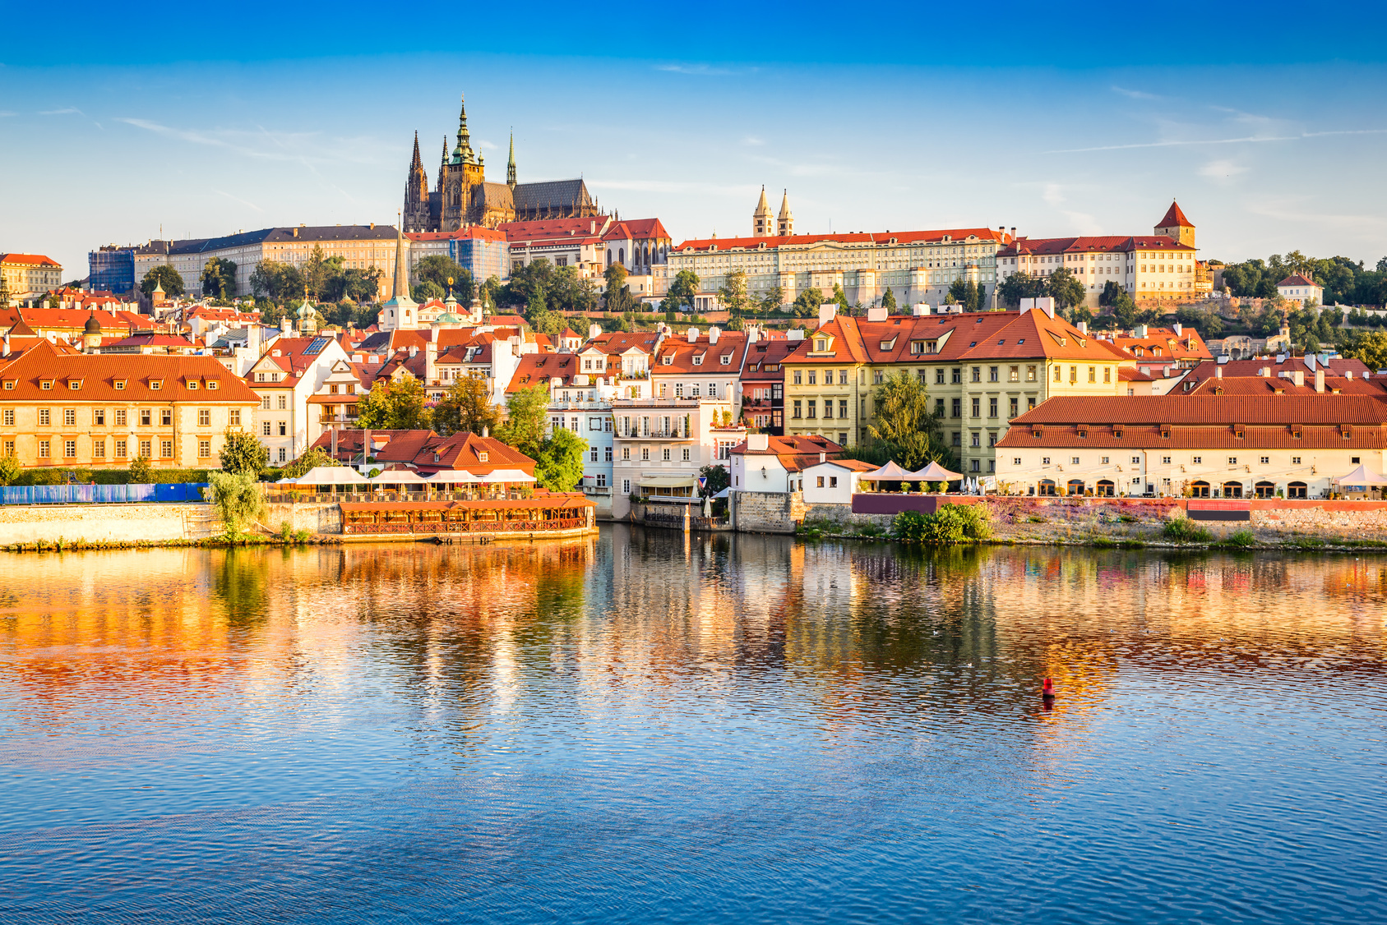
PRAGUE, CZECH REPUBLIC
After landing in Prague, we will transfer to our first hotel.

Slide 5
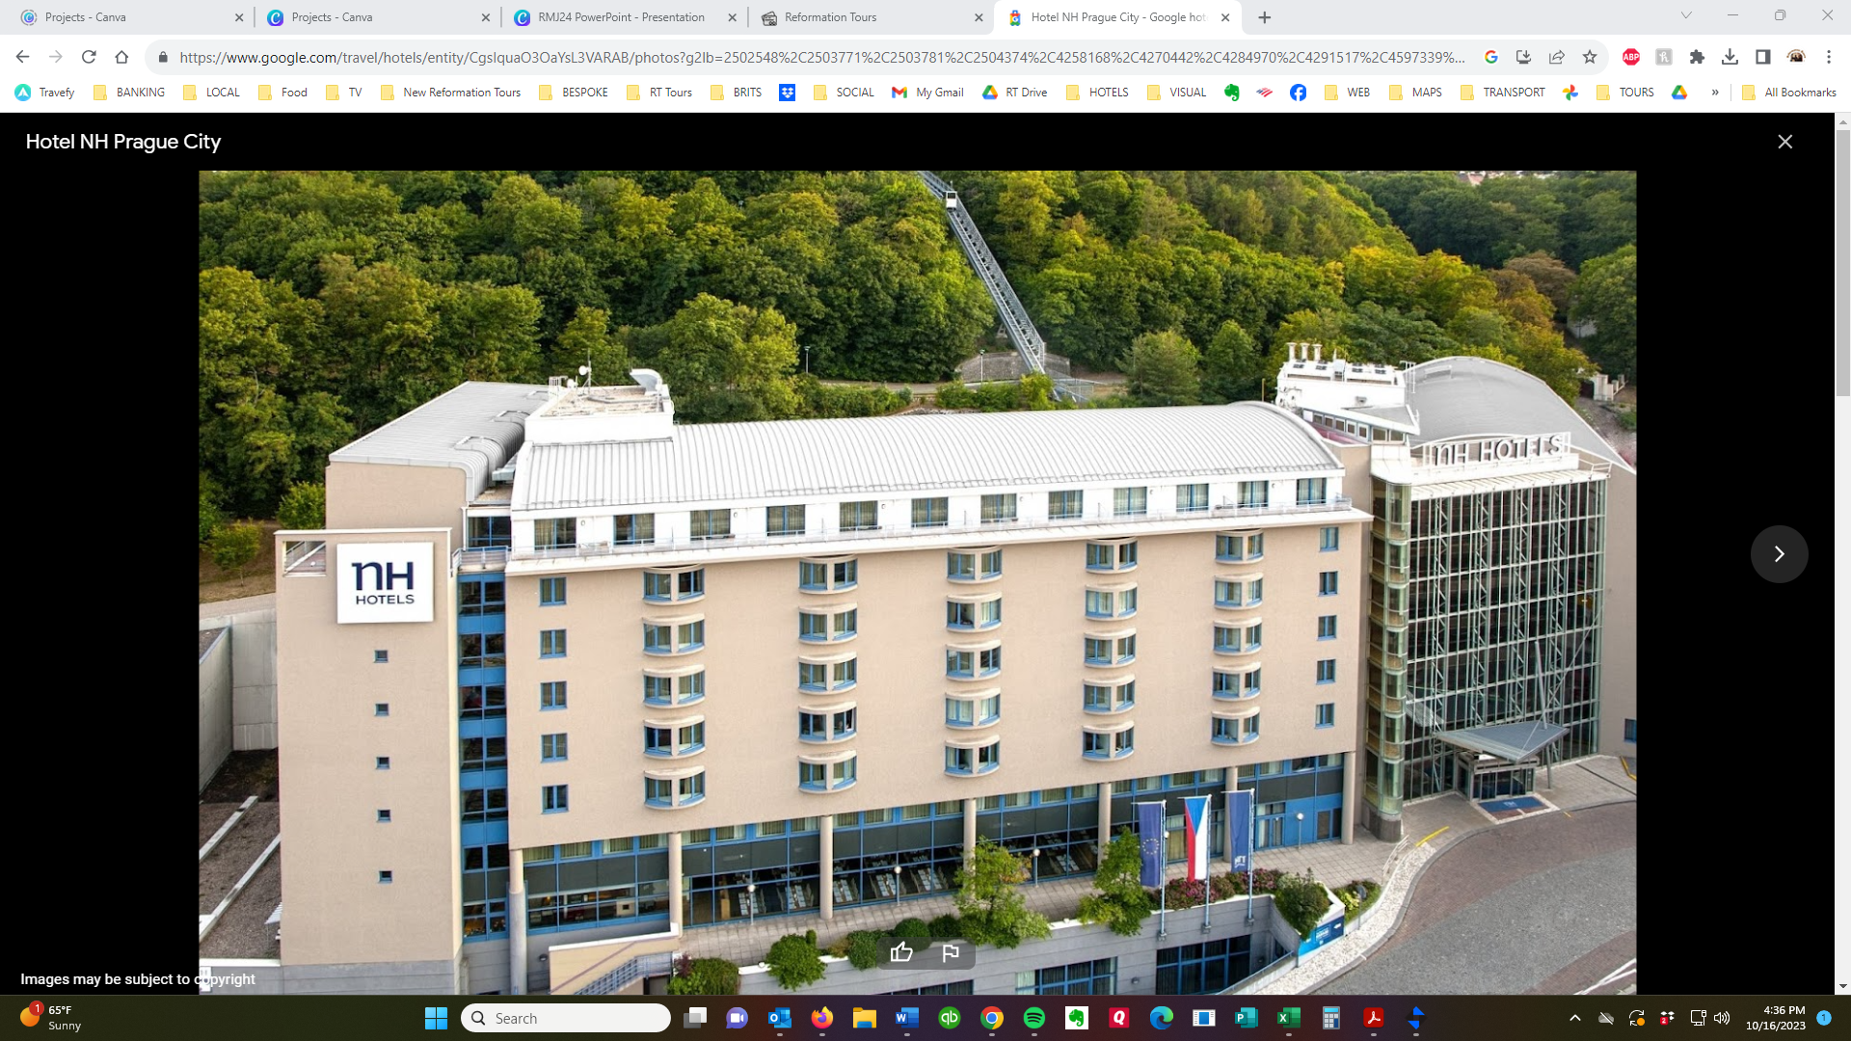
NH PRAGUE CITY HOTEL
The 4-star NH Prague City Hotel is close to the city center and has many amenities, including a gym, sauna, restaurant terrace, air-conditioning and free Wi-Fi.

Slide 6
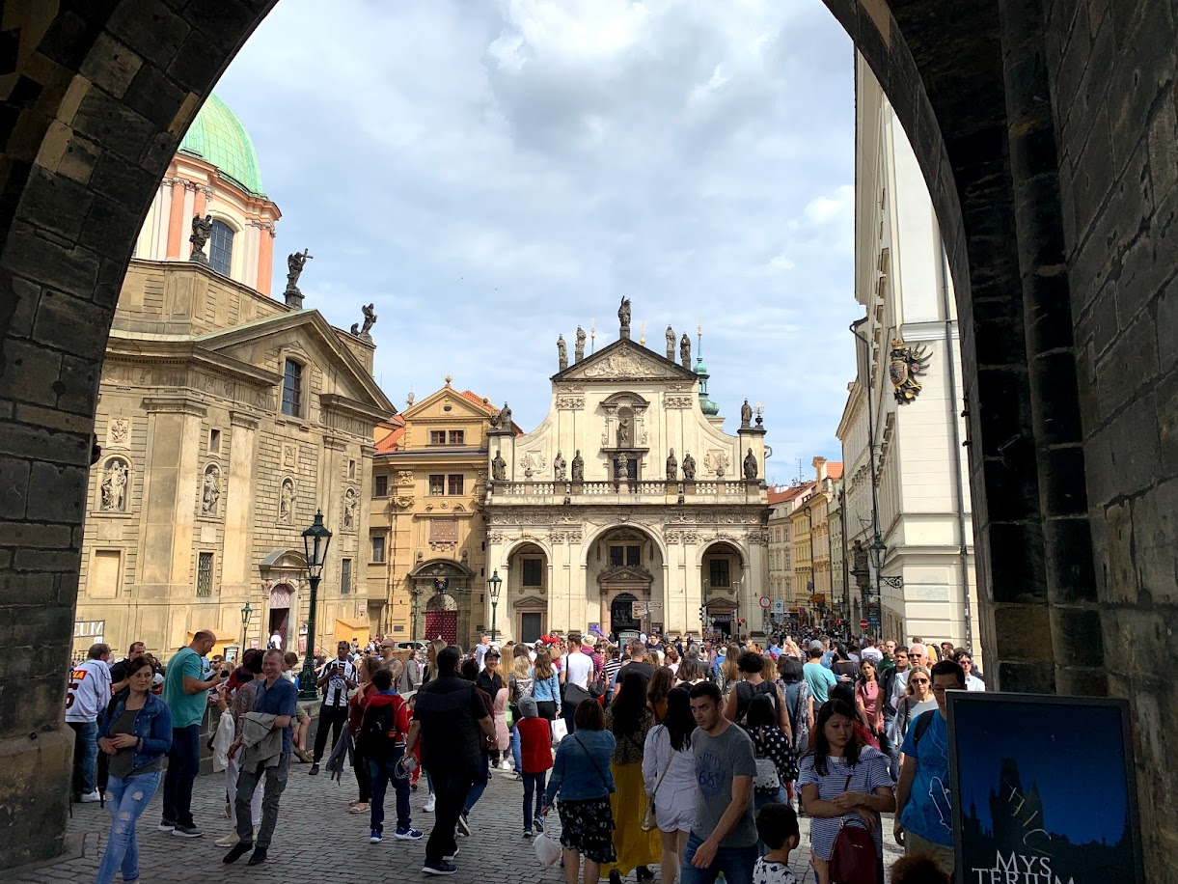
PRAGUE TOUR
Our walking tour will be focused on Jan Hus, the leading personality of the Czech Reformation movement. We’ll visit Bethlehem Chapel where he preached and see the Hus monument outside Týn Church. Hus was a contemporary of John Wycliffe and was heavily influenced by his writings. They both agreed that all Christians are members of Christ’s church, and that Jesus is the head. .

Slide 7
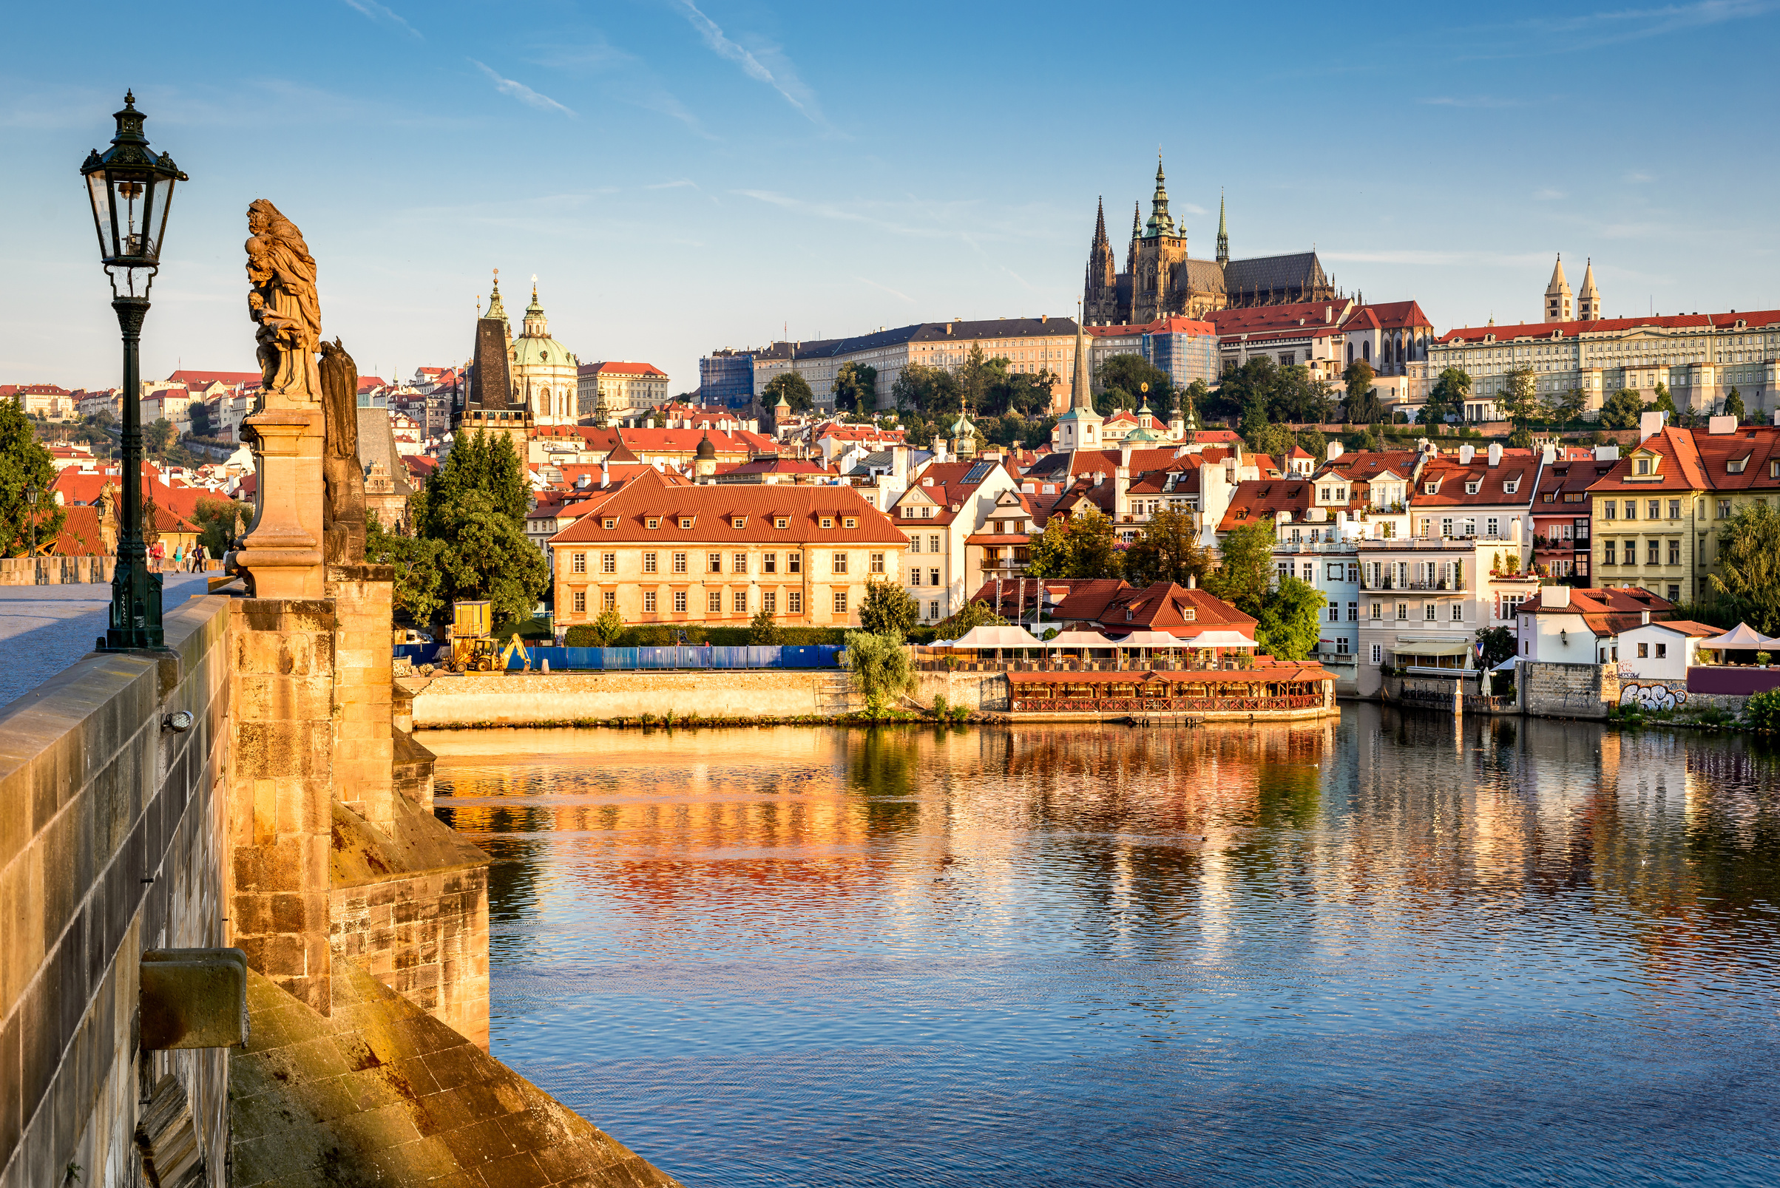
PRAGUE CASTLE
After a free morning to attend an English language church service, we will explore Prague Castle, a complex of palaces, courtyards, streets and churches including St. Vitus Cathedral, which took 600 years to complete.

Slide 8
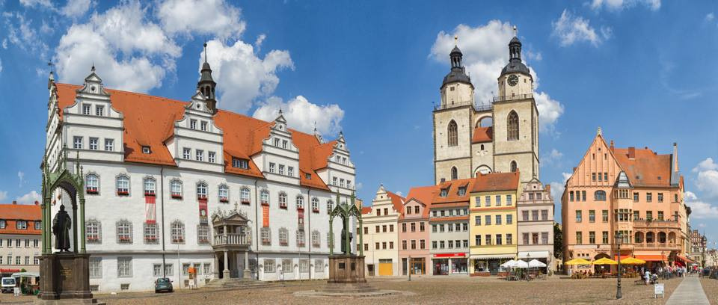
LUTHERSTADT-WITTENBERG
We will cross the border into Germany this morning and travel to Lutherstadt Wittenberg. It was here in 1517 that Martin Luther nailed his famous 95 Theses to the door of Castle Church (Schlosskirche). We will see St. Mary’s Church where Luther regularly preached and the Old Latin School next door. Luther’s former home, is now a Reformation Museum.

Slide 9
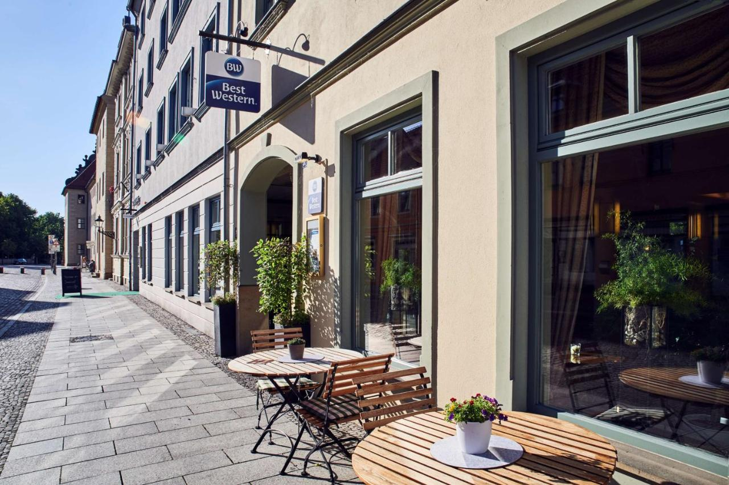
BEST WESTERN SOIBELMANNS
The Best Western Stadtpalais Wittenberg hotel is a 4 star hotel situated in the heart of the city, close to the famous Lutherhaus Museum and the Melanchthon House. The hotel has a charming courtyard behind the hotel and offers free Wi-Fi.

Slide 10
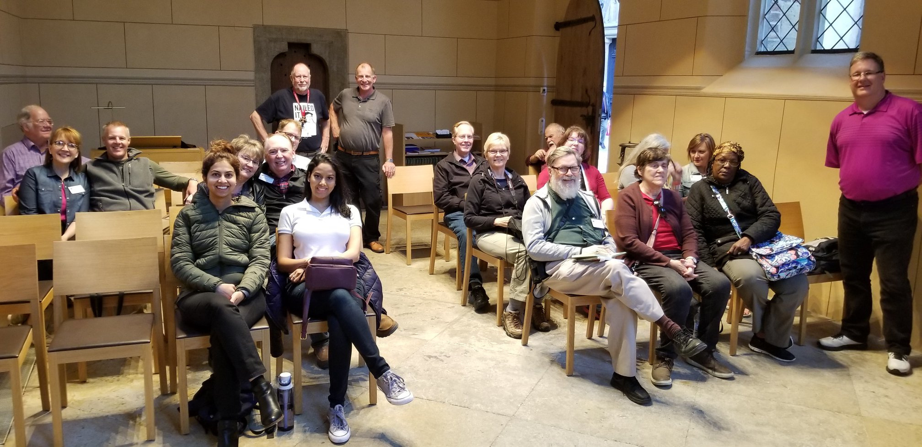
The tour will include times of worship and fellowship in key locations, such as Wittenberg

Slide 11
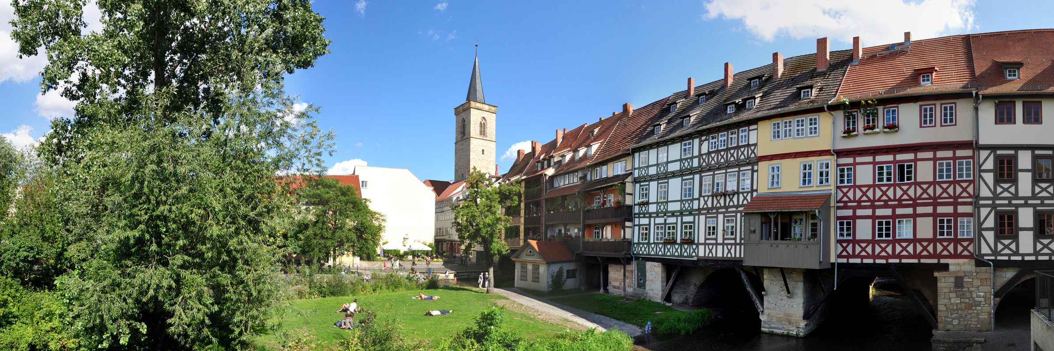
ERFURT
We’ll drive to Erfurt and have free time for lunch. We’ll visit St. Mary’s Cathedral, St. Severin’s Church and the famous Merchant’s Bridge, then tour the Augustinian Monastery where Luther became a monk on July 17, 1505. We will be able to see his monastic quarters, including one cell furnished to look as it would have when he lived there. At the end of the tour we will have a group time in the chapel.

Slide 12
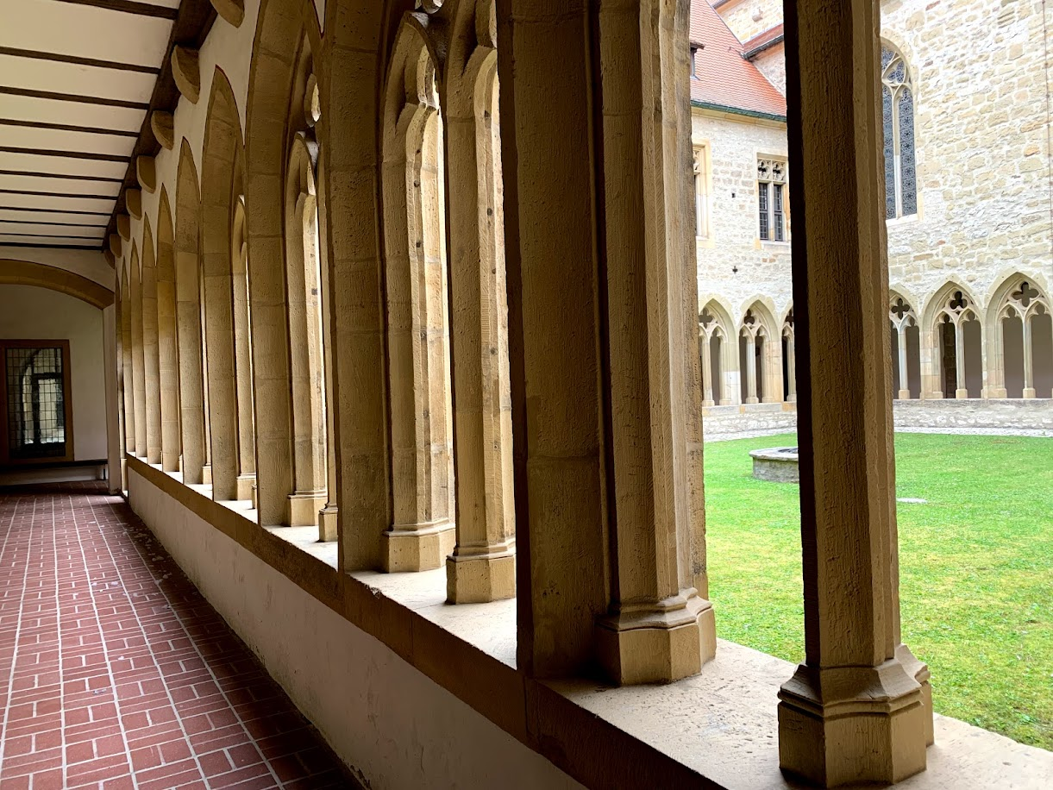

Slide 13
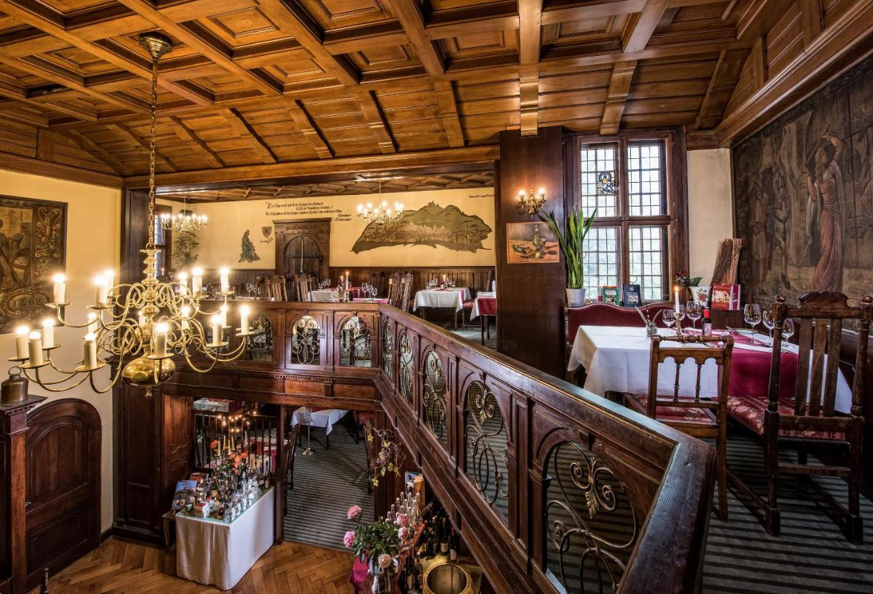
HOTEL KAISERHOF
The 4 star Hotel Kaiserhof is in the center of Eisenach.
Dating back to 1897, it offers traditional accommodation with individually decorated rooms, finished with floral, English-style fabrics.
The historic Turmschänke wine restaurant offers Gault Millau awarded cooking make with fresh ingredients.

Slide 14
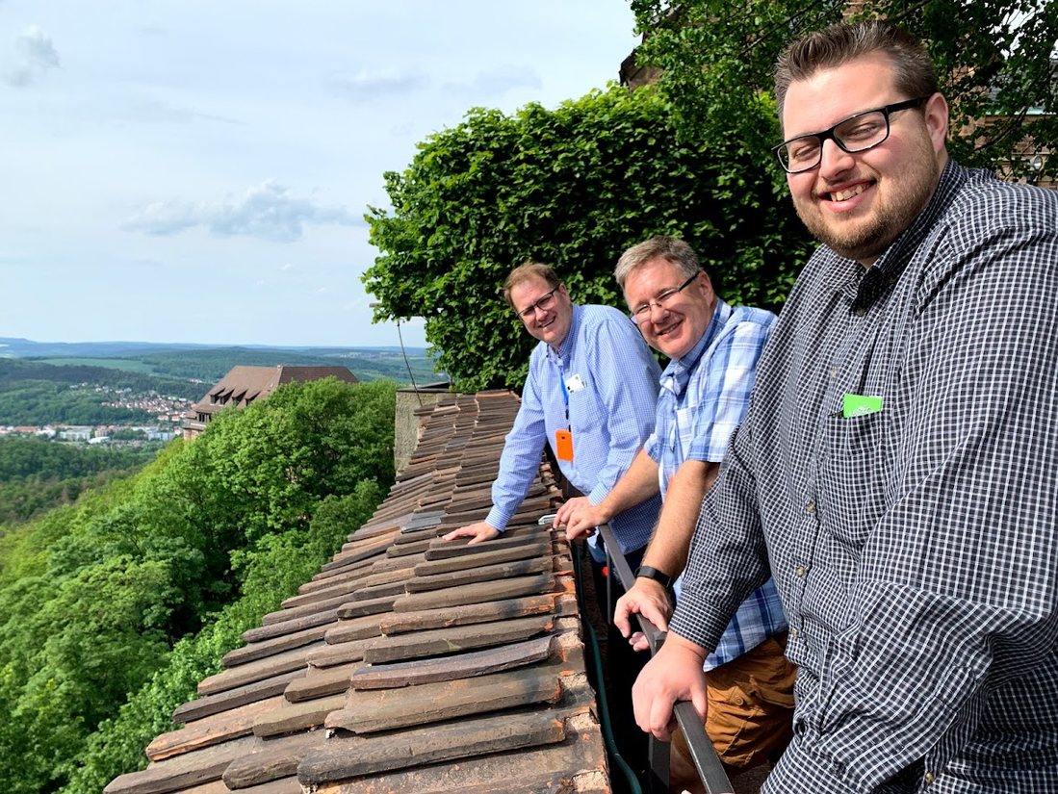
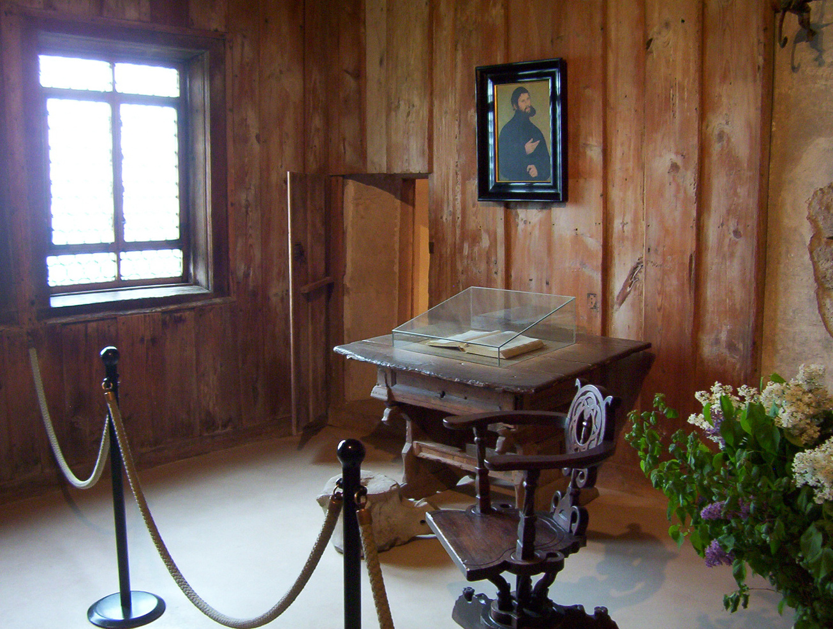
WARTBURG CASTLE
In 1521, while fleeing from the wrath of the Pope, Luther took refuge in the Wartburg Castle after a fake kidnapping staged by his friend and protector, Frederick the Wise. We will tour the Wartburg and see where Luther finished translating the New Testament into German in just eleven weeks.

Slide 15
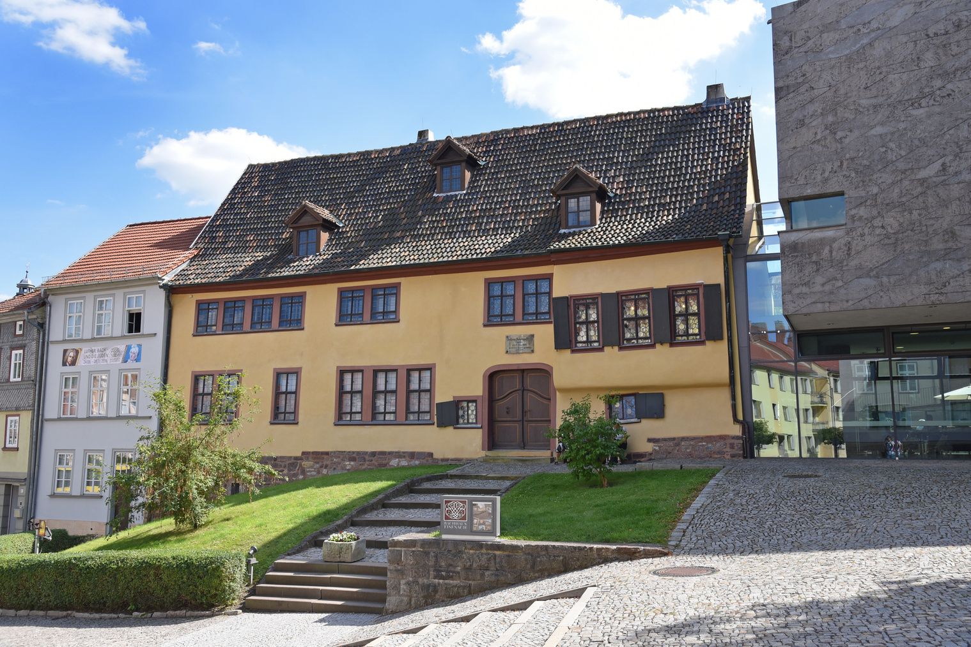
EISENACH
Luther spent time in the nearby town of Eisenach as schoolboy and sang in the choir of St. George’s Church, where the Bach family also worshiped.
The afternoon will be free to explore the town of Eisenach, before we will drive down to the Rhine region and dine in our hotel.

Slide 16
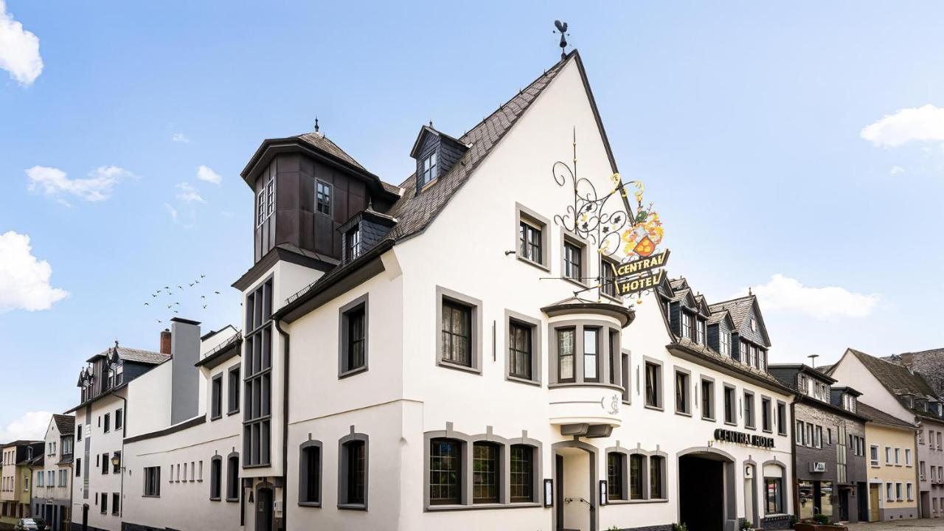
RINGHOTEL CENTRAL
Surrounded by scenic vineyards in the heart of the wine-growing town of Rüdesheim, this family-run 3-star hotel provides a picturesque setting directly along the River Rhine. .

Slide 17
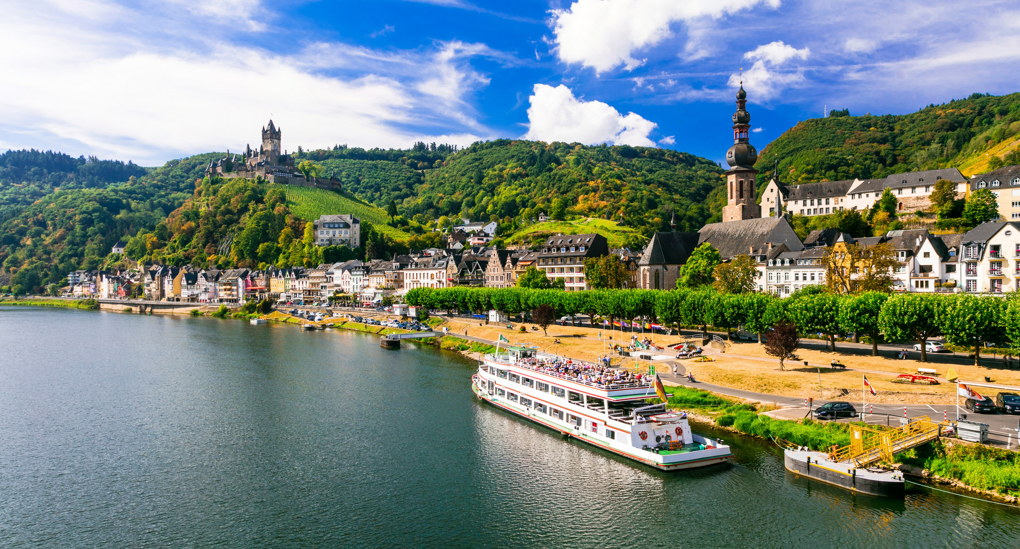
RÜDESHEIM
What better way to start the day than with a Rhine cruise!
We’ll board the boat and sail past magnificent castles and the famous Loreley rock.

Slide 18
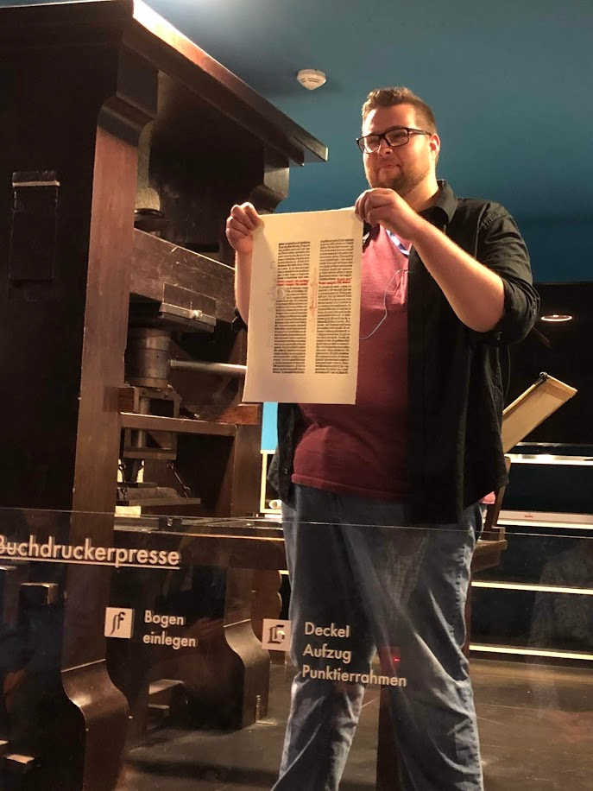
MAINZ
After the cruise we will tour the Gutenberg Museum, including a printing demonstration. We will also tour the Cathedral in Mainz.

Slide 19
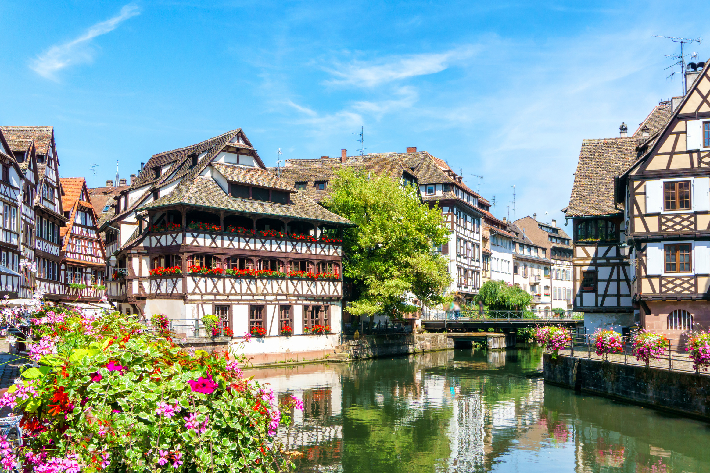
STRASBOURG
Strasbourg was an important town for John Calvin. He pastored French Huguenot refugees, got married, and wrote a second edition to his famous book, the Institutes. Strasbourg, as a free imperial town, was a beacon for Protestantism right from the 16th century.

Slide 20
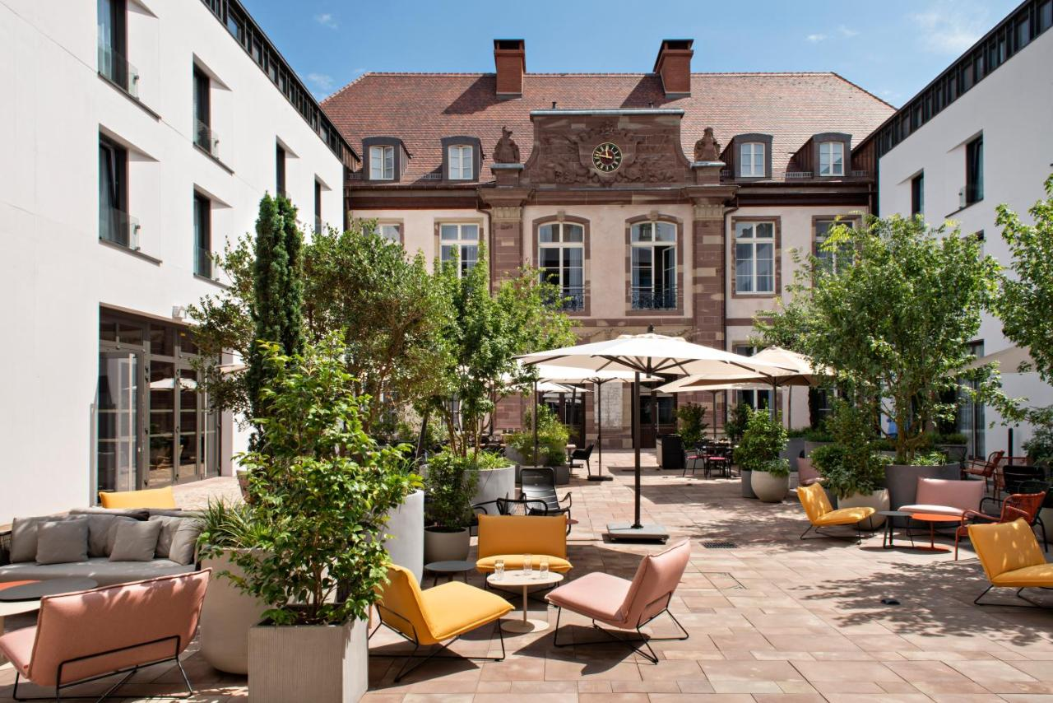
HOTEL LEONOR
The 4-star Hotel Leonor is located in the center of Strasbourg in an historic 18th century building.
There’s a sunny inner courtyard that’s popular with locals and hotel guests.
There is a bar- restaurant-patisserie with excellent food.

Slide 21
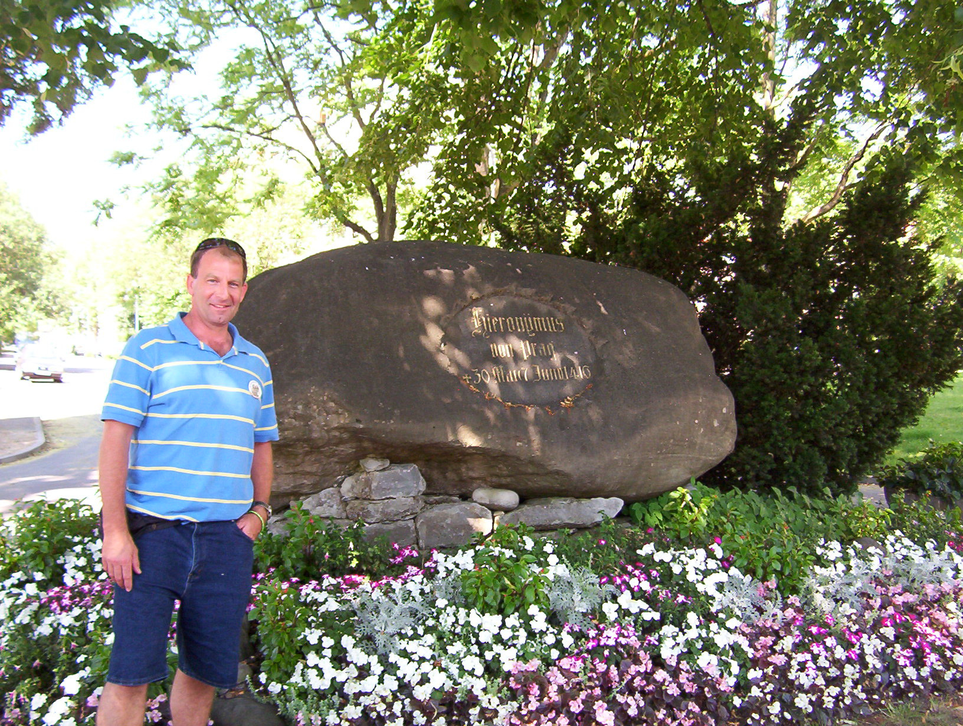
CONSTANCE
Today we will be in three countries: France, Germany and Switzerland. We will drive through the Black Forest region to the border of Switzerland. In Constance, we will pray on the spot where the pre-Reformer Jan Hus was martyred and see the Cathedral where some of the trials were held.

Slide 22
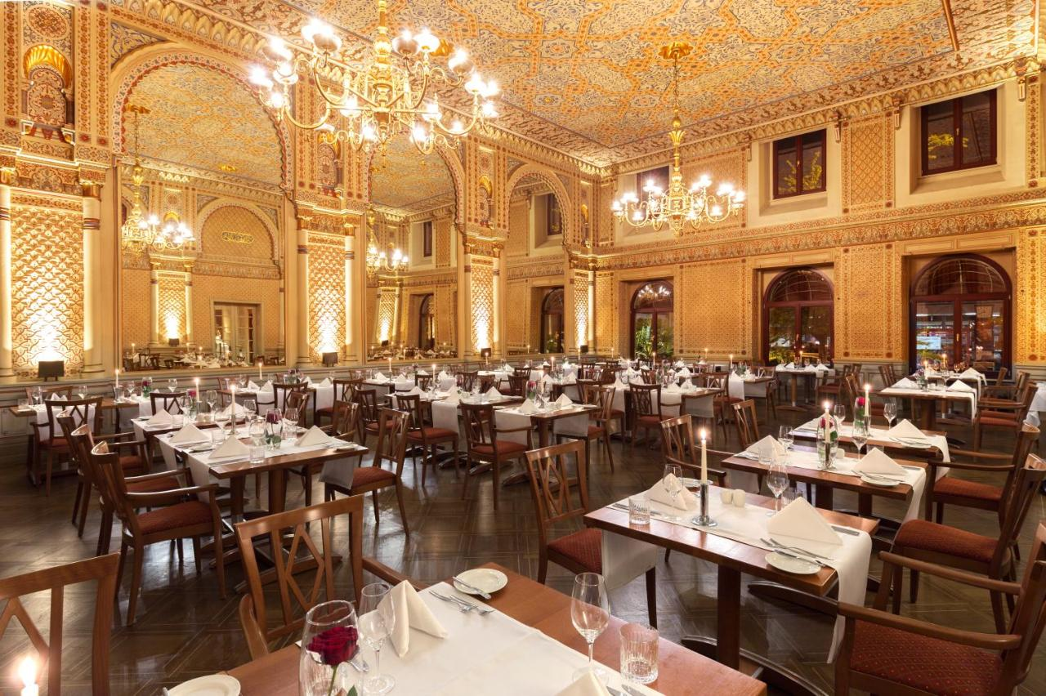
HOTEL HALM
The 3-star Hotel Halm is located in the center of Constance, 3-minutes walk from the lake.
The classic-style hotel was founded in 1874 and retains many period features, along with free WiFi.
Meals are served in the “Moorish Hall”.

Slide 23
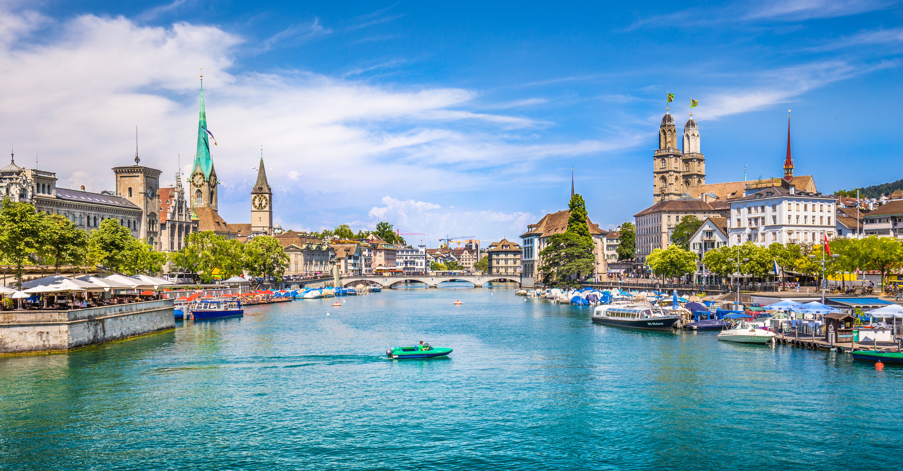
ZURICH
We will visit key Reformation sites to learn about Zwingli and the Anabaptists. We will tour the Grossmünster, the Helferei (where Zwingli lived) and see the Zwingli Statue.

Slide 24
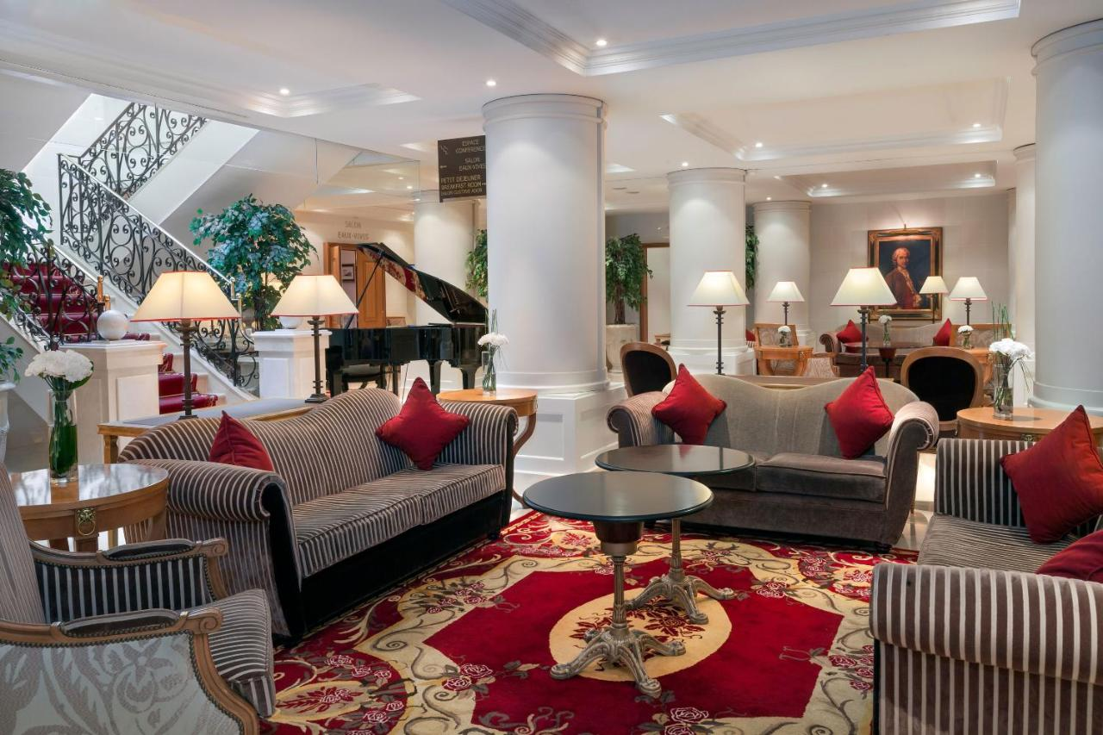
ROYAL MANOTEL
The 4-star Royal Manotel is a 5-minute walk from Geneva Train Station, the Old Town and Lake Geneva It offers elegant rooms with period furniture and free WiFi. The rooms are all air-conditioned and feature rich fabrics, high-quality beds and stylish bathrooms. Tea and coffee making facilities are available in all of them.

Slide 25
WHAT’S INCLUDED
  Transportation: via deluxe air-conditioned coach
  Group arrival and departure transfers
  Accommodations (double-occupancy) in superior 3-star and moderate 4-star hotels
  Meals as indicated in the itinerary
  Professional Tour Director throughout the tour
  Local step-on guides for city tours and major attractions
  Whisper headsets
  Admission to all activities indicated in the itinerary
  All taxes and tips – other than tour director and driver
  Trip app and full color tour book

Slide 26
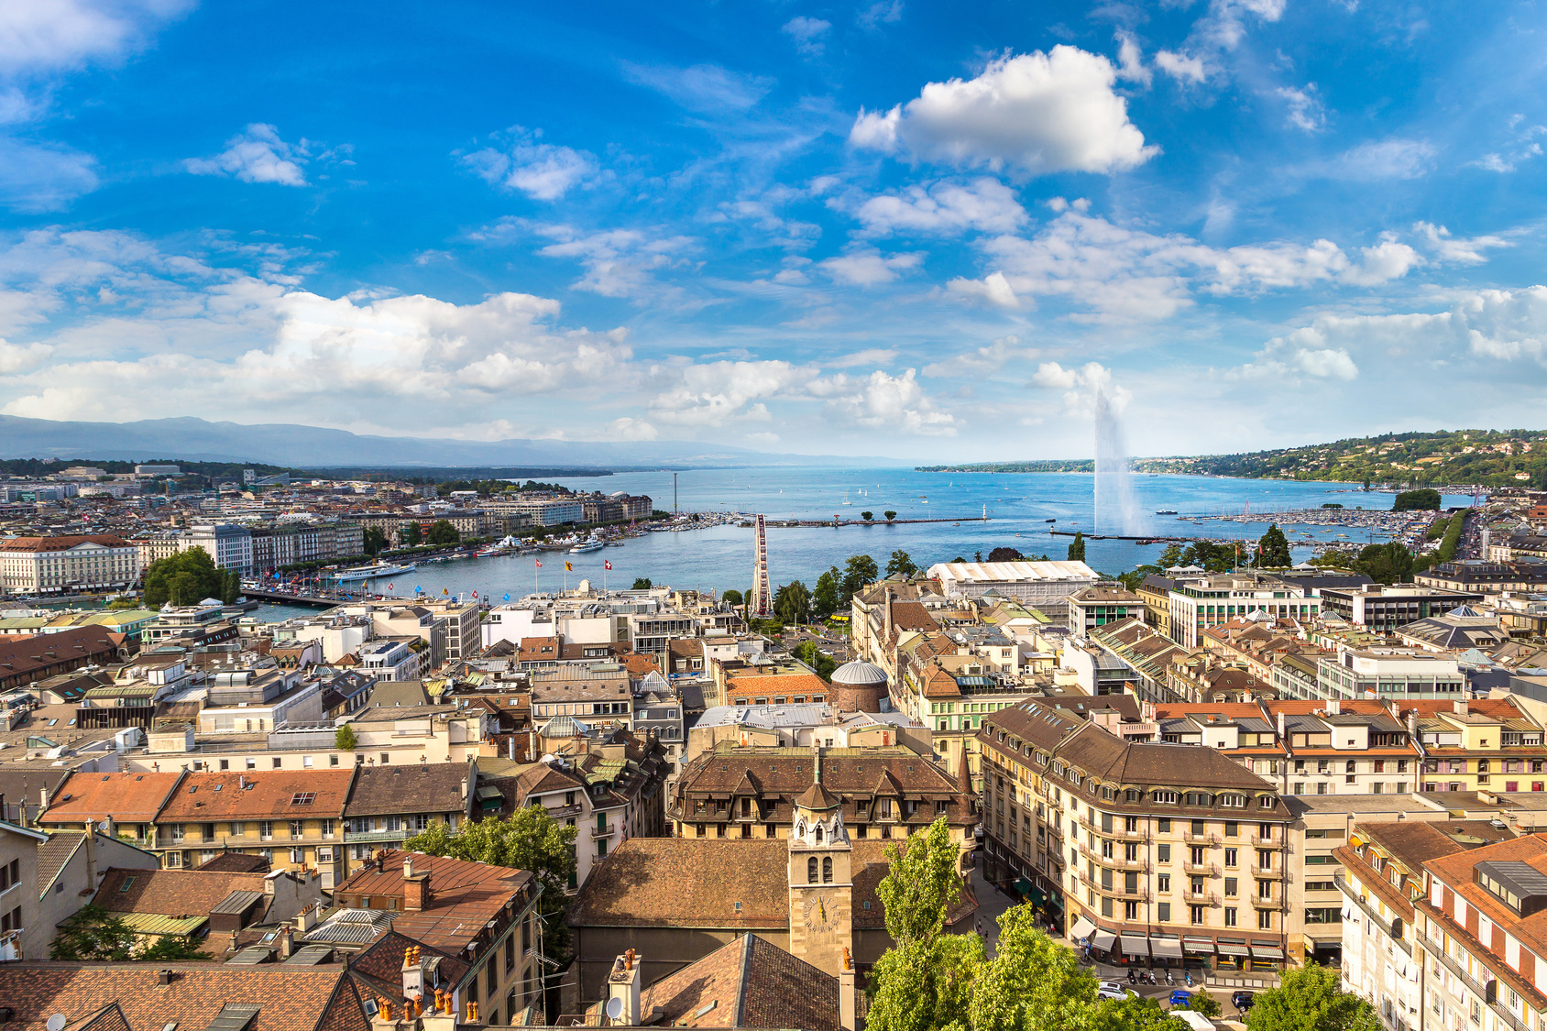
WHAT’S NOT INCLUDED
  Round-trip air transportation and related taxes and fees ($1,875 from Chicago)
  Arrival and departure transfers
  Single supplement ($850)
  Meals and beverages not identified in itinerary
  Items of a personal nature, such as passports and visas. Passports must be valid for 6 months beyond return date.
  Passenger trip cancellation insurance
  Tips for tour director and driver

Slide 27
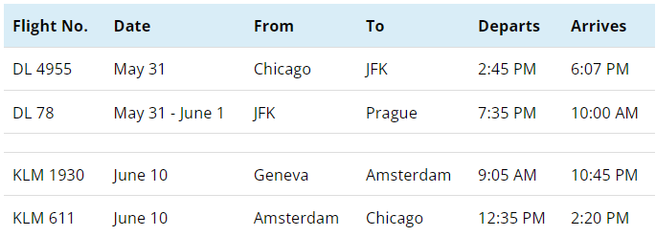
FLIGHTS
Round-trip air transportation is available for $1,875. Once the tour is a guaranteed departure, we can assist with air from other cities.

Slide 28
HOW TO REGISTER
SIGN UP: Please click the registration link on the website: ReformationTours.com/package/RMJ24.
PAYMENT METHOD: Payments can be made directly on the registration platform, using a credit card (3.5% fee), or a bank debit. You can also send checks made payable to “Reformation Tours” at 12316 244th St., Chisago City, MN 55013-9688.
FIRST DEPOSIT: A $350 per person
FINAL PAYMENT: Due by March 2, 2024.
TRAVEL INSURANCE: We highly recommended insuring your tour and there are two options. Enhanced insurance needs to be paid within two weeks of paying the deposit.
I

